Slide 1
Introduction to Java
v103

Slide 2
The Most Common Data Types
Data Type | Data Example
String | "George"
int | 10
double | 3.1415
boolean | true or false
char | 'A' or 'a'

Slide 3
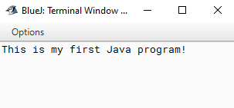
First Program
/**
* This is a simple Java program which prints one line to the monitor
*
* @author James Bond
* @version v100
*/
public class firstProgram
{ //class
public static void main(String args[])
{ //main
System.out.println("This is my first Java program!");
} //main
} //class

Slide 4
more Data Types for Numbers
There are six numeric types four integer and two floating point:
byte 1 byte -128 to 127.
short 2 bytes -32,768 to 32,767.
int 4 bytes -2,147,483,648 to 2,147,483,647.
long 8 bytes -9,223,372,036,854,775,808 to 9,223,372,036,854,775,80.
float 4 bytes 7 decimal digits.
double 8 bytes 16 decimal digits.

Slide 5
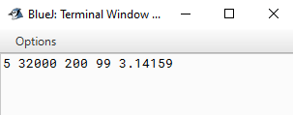
public class OutputtingNumbers
{ //class
public static void main(String[] args)
{ //main
byte b = 5;
short s = 32000;
int i = 200;
long m = 99;
double pi = 3.14159;
System.out.print( b + " ");
System.out.print( s + " ");
System.out.print( i + " ");
System.out.print( m + " ");
System.out.print( pi+ " ");
System.out.println();
} //main
} //class
Outputting Numbers

Slide 6
Escape Characters
Some of the characters you may want to display might need special treatment.
Escape Characters | How to Print in Java
a tab (usually 7 or 8 spaces) | System.out.println( “\t” );
the backslash, i.e. \ | System.out.println( “\\” );
a return (advances to next line) | System.out.println( “\n” ); or System.out.println( );

Slide 7
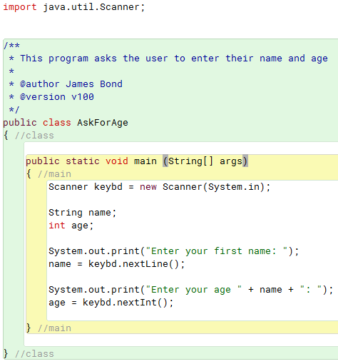
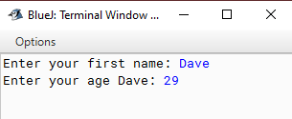
Getting User Input into a Variable
1. Attach the Scanner library
2. Create keybd object of type Scanner
3. Read a string than an integer.

Slide 8
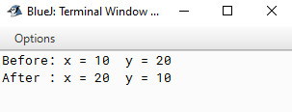
Swappng Two ints
/**
* This program demonstrates swapping two integers.
*
* @author James Bond
* @version v100
*/
public class NumbersPgm
{ //class
public static void main(String args[])
{ //main
int x = 10;
int y = 20;
int temp = 0;
//to swap the values in x & y, you need a third variable temp
System.out.println ("Before: x = "+ x + " y = " + y);
temp = x;
x = y;
y = temp;
System.out.println ("After : x = "+ x + " y = " + y);
} //main
} //class

