Slide 1
Documentation
Introduction to JavaDoc
v101

Slide 2
JavaDoc
What is JavaDoc?
Javadoc is a tool which comes with Java.
Javadoc is used to create documentation for your program in HTML format.

Slide 3
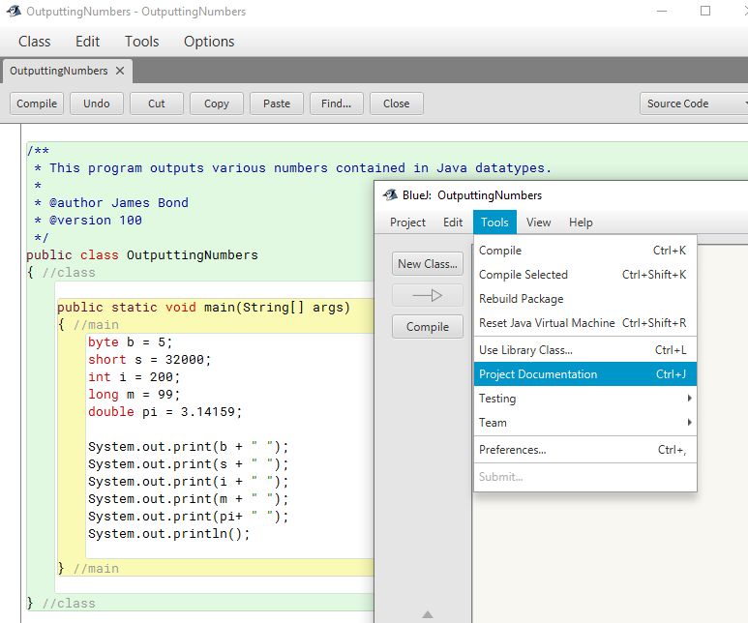

Slide 4
JavaDoc Variables | Example | Description
@author | @author James Bond | displays author’s name
@version | @version 1.0 | Specifies the version number of the program or method
@since | @since 2021-08-25 | Specifies when this version was added to the project
@param | @param url is the web address | Provides a useful description about method inputs
@return | @return | Provides a description of what a method will return

Slide 5
/**
* <h1>Hello, World!</h1>
* <p>
* The HelloWorld program implements an application that
* simply displays "Hello World!" to the standard output.
* </p><p>
* Giving proper comments in your program makes it more
* user friendly and it is assumed as a high quality code.
* </p>
*
* @author James Bond
* @version 1.0
* @since 2021-08-25
*/
public class HelloWorld
{
public static void main(String[] args) {
System.out.println("Hello World!");
}
}
Note that JavaDoc allows HTML tags

Slide 6
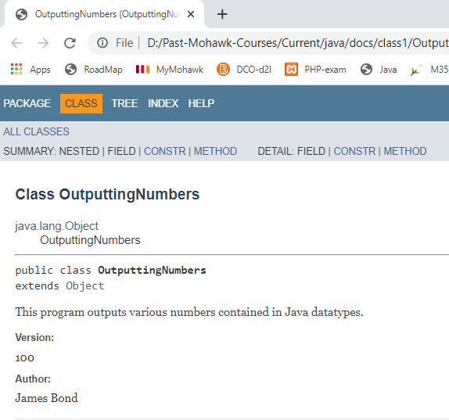

Slide 7
In summary
Always document your main program and static class methods with JavaDoc.
If you do, you’ll get your documentation automatically created for you.

