Slide 1
Strings & Numbers
v101

Slide 2
String Static Methods - length()
public static void main (String[] args)
{ //main
String phrase = "Mohawk College";
//index numbers
System.out.println( phrase );
System.out.println("01234567890123" );
System.out.println(" length: " + phrase.length() );
} //main

Slide 3
String Static Methods - the + sign
public static void main (String[] args)
{ //main
String phrase = "Mohawk College";
//index numbers
System.out.println( phrase );
System.out.println("01234567890123" );
// + sign means concatenation
System.out.println(phrase + "\n" + "Department of Computer Science");
} //main

Slide 4
String Static Methods - toUpperCase( )
public static void main (String[] args)
{ //main
String phrase = "Mohawk College";
//index numbers
System.out.println( phrase );
System.out.println("01234567890123" );
//upper case
System.out.println(phrase.toUpperCase() );
} //main

Slide 5
String Static Methods - contains( )
public static void main (String[] args)
{ //main
String phrase = "Mohawk College";
//index numbers
System.out.println( phrase );
System.out.println("01234567890123" );
//contains
System.out.println(phrase.contains("w") );
System.out.println(phrase.contains("Academy") );
} //main

Slide 6
String Static Methods - charAt()
public static void main (String[] args)
{ //main
String phrase = "Mohawk College";
//index numbers
System.out.println( phrase );
System.out.println("01234567890123" );
//character index number
System.out.println( phrase.charAt(4) );
} //main

Slide 7
String Static Methods - indexOf()
public static void main (String[] args)
{ //main
String phrase = "Mohawk College";
//index numbers
System.out.println( phrase );
System.out.println("01234567890123" );
//index number
System.out.println( phrase.indexOf("w") );
} //main

Slide 8
String Static Methods - lastIndexOf( )
public static void main (String[] args)
{ //main
String phrase = "Mohawk College";
//index numbers
System.out.println( phrase );
System.out.println("01234567890123" );
//last index number
System.out.println( phrase.lastIndexOf("o") );
} //main

Slide 9
String Static Methods - substring( )
public static void main (String[] args)
{ //main
String phrase = "Mohawk College";
//index numbers
System.out.println( phrase );
System.out.println("01234567890123" );
//substring
System.out.println( phrase.substring(7) );
System.out.println( phrase.substring(2,6) );
} //main

Slide 10
String Static Methods - Combining Methods
public static void main (String[] args)
{ //main
String phrase = "Mohawk College";
//index numbers
System.out.println( phrase );
System.out.println("01234567890123" );
//combining methods
System.out.println(phrase.substring(2,6).length( ) );
} //main

Slide 11
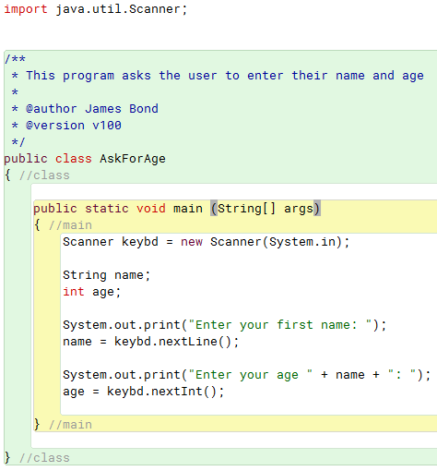
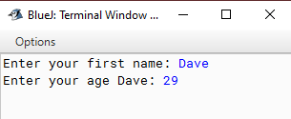
Getting User Input into a Variable
1. Attach the Scanner library
2. Create keybd object of type Scanner
3. Read a string than an integer.

Slide 12
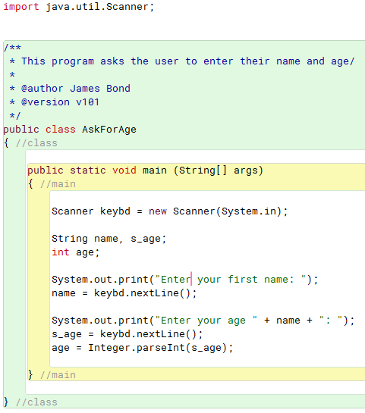
USER Input should ALWAYS, ALWAYS, ALWAYS
be done using a String variable, -- to prevent program crashes
…so the previous program should be written like this

Slide 13
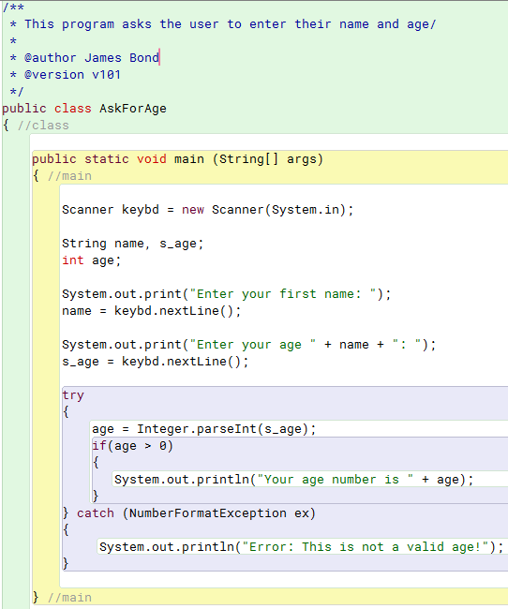
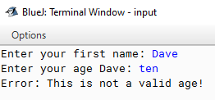
Data Validation
We always read data into a String variable from the user. This allows us do perform data validation on what we are given.

