Slide 1
IF statements
v103

Slide 2
Logic of an if statement
condition
true
false
statement

Slide 3
if statement syntax:
The condition must be a
boolean expression. It must
evaluate to either true or false.
if is a Java
reserved word
if ( condition )
statement;
If the condition is true, the statement is executed.
If it is false, the statement is skipped.

Slide 4
Boolean Expressions
== equal to
!= not equal to
< less than
> greater than
<= less than or equal to
>= greater than or equal to
Note the difference between the equality operator (==) and the assignment operator (=)
higher
precedence

Slide 5
IF Example
max = -999;
if (sum > max)
max = sum;
System.out.println("The largest number is " + max);

Slide 6
Logical Operators
Comparisons can also use the following logical operators:
! Logical NOT
&& Logical AND
|| Logical OR

Slide 7
Precedence
//NOT has higher precedence than logical AND and OR
if (index < max && !found)
System.out.println ("keep going…");
All logical operators (ie, && and ||) have lower precedence than
the relational operators (eg < > != ==), which have lower precedence than
arithmetic operators (eg + * - /).

Slide 8
Truth Tables
a | b | a && b | a || b
true | true | true | true
true | false | false | true
false | true | false | true
false | false | false | false

Slide 9
if else
if ( condition )
statement1;
else
statement2;
//if the condition is TRUE, then statement1 is executed.
//otherwise, statement2 is executed

Slide 10
if else if else
if (percent >= 90.0)
letter = "A";
else if (percent >= 80.0)
letter = “B";
else if (percent >= 70.0)
letter = “C";
else if (percent >= 50.0)
letter = “D";
else
letter = "F";

Slide 11
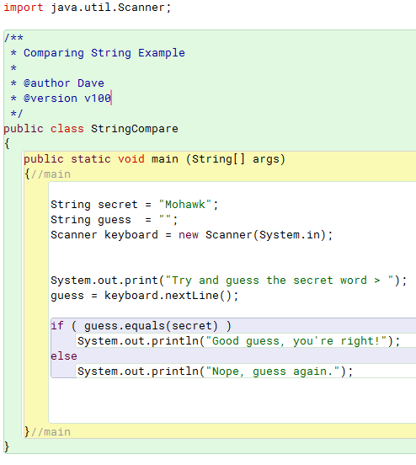
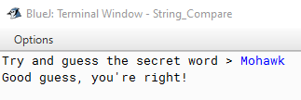
Comparing Strings
When comparing strings, use the method: .equals( )
if (secret == guess)
if (guess.equals(secret) //returns true or false

