Slide 1
While loops
v100

Slide 2
While Loop Syntax
while (condition)
{ // code block to be executed
}

Slide 3
While Loop Syntax
int i = 0;
while (i < 5)
{
System.out.println(i);
i++;
}

Slide 4
The Do/While Loop Syntax
do {
// code block to be executed
}
while (condition);

Slide 5
The Do/While Loop Syntax
int i = 0; do {
System.out.println(i);
i++;
} while (i < 5);

Slide 6
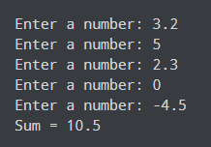
import java.util.Scanner;
class UserInputSum {
public static void main(String[] args) {
Double number, sum = 0.0;
// create an object of Scanner
Scanner input = new Scanner(System.in);
while (true) {
System.out.print("Enter a number: ");
// takes double input from user
number = input.nextDouble();
// if number is negative the loop terminates
if (number < 0.0) {
break;
}
sum += number;
}
System.out.println("Sum = " + sum);
}
}
break; statement

Slide 7
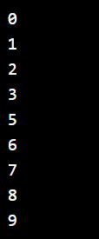
continue; statement
int i = 0;
while (i < 10)
{
if (i == 4)
{
i++;
continue;
}
System.out.println(i);
i++;
}

