Slide 1
Java built-in Arrays (also known as Vectors or Lists)
Interactive Exercise
v100

Slide 2
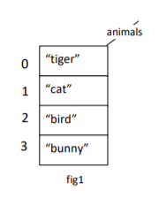
Question 1

Slide 3
Question 1
String[] animals = new String[4];
animals[0] = "tiger";
animals[1] = "cat";
animals[2] = "bird";
animals[3] = "bunny";

Slide 4
Question 2

Slide 5
Question 2
String cage = "dog";
or
String cage;
cage = "Dog";

Slide 6
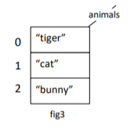
Question 3

Slide 7
Question 3
animals[2] = animals[3];

Slide 8
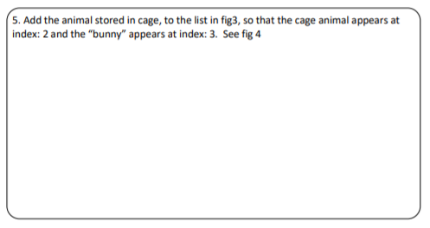
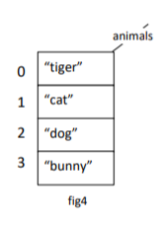
Question 4

Slide 9
Question 4
animals[3] = animals[2];
animals[2] = cage;

Slide 10
Question 5

Slide 11
Question 5
animals[2] = "bird";
System.out.println( "The " + animals[1] + " is chasing the " + animals[2] );

Slide 12
Question 6

Slide 13
Question 6
for(int i=0; i< animals.length; i++)
{
System.out.println(animals[i]);
}

Slide 14
Question 7
How to you change your array from fig 1 to fig 4?

Slide 15
Question 7
How to you change your array from fig 1 to fig 4?
animals[2] = "dog";

