Slide 1
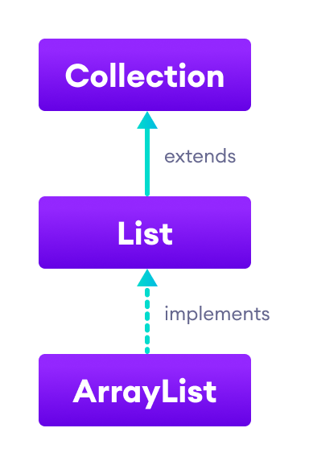
ArrayLists (also known as Vectors or Lists)
Interactive Exercise
v102
by Dave Slemon, Mohawk College

Slide 2
Interactive Exercise on ARRAYLISTS
Recommended:
Type and execute each of the answers one by one that are presented here.

Slide 3
Instructions for this Interactive Exercise on ARRAYLISTS
Remember to import the ArrayList library
import java.util.ArrayList;
…and if you plan on sorting your ArrayList include the Collections library
import java.util.Collections;

Slide 4
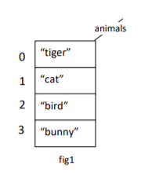
Q1
then display the arraylist to the screen
[tiger, cat, bird, bunny]

Slide 5
Q1
ArrayList<String> animals = new ArrayList<String>();
//ArrayList<String> animals = new ArrayList<>();
animals.add("tiger“);
animals.add(“cat“);
animals.add(“bird“);
animals.add(“bunny“);
System.out.println( animals );
Video Screen
[tiger, cat, bird, bunny]

Slide 6
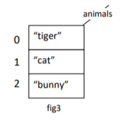
Q2

Slide 7
Q2
If multiple “birds” are in the array, this line only removes the first “bird”
animals.remove(“bird”);
or
animals.remove(2);

Slide 8
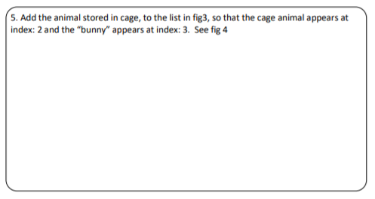
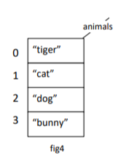
Q3

Slide 9
Q3
animals.add(2,cage);

Slide 10
Q4

Slide 11
Q4
System.out.println( animals.size( ) );

Slide 12
Q5

Slide 13
Q5
System.out.println( “The “ + animals.get(1)
+ “ is chasing the “+ animals.get(2) );

Slide 14
Q6

Slide 15
Q6
animals.clear( );
or
animals.removeAll( );

Slide 16
Q7

Slide 17
Q7
for (int i=0;
i < animals.size();
i++)
{
System.out.println( animals.get(i) );
}

Slide 18
Q7
//enhanced for loop
for (String a : animals)
{
System.out.println( a );
}

Slide 19
Q8
How to you transform your ArrayList from fig 1 to fig 4?

Slide 20
Q8
animals.set(2,”dog”);

Slide 21
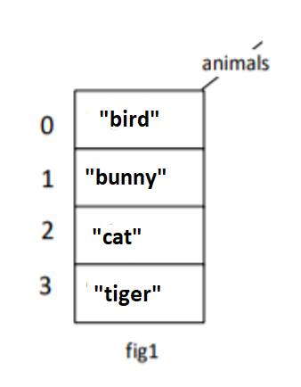
Q9 Sorting
How to you sort the ArrayList?

Slide 22
Q9 Sorting
import java.util.Collections;
Collections.sort( animals );

Slide 23
.clone method
Creates a new arraylist with the same element, size,
and capacity.
import java.util.ArrayList;
class Main {
public static void main(String[] args){
// create an arraylist
ArrayList<Integer> number = new ArrayList<>();
number.add(1);
number.add(3);
number.add(5);
System.out.println("ArrayList: " + number);
// create copy of number
ArrayList<Integer> cloneNumber = (ArrayList<Integer>)number.clone();
System.out.println("Cloned ArrayList: " + cloneNumber);
}
}
ArrayList: [1, 3, 5]
Cloned ArrayList: [1, 3, 5]

Slide 24
import java.util.ArrayList;
class Main {
public static void main(String[] args) {
// create an ArrayList
ArrayList<String> languages = new ArrayList<>();
System.out.println("Newly Created ArrayList: " + languages);
// checks if the ArrayList has any element
boolean result = languages.isEmpty(); // true
System.out.println("Is the ArrayList empty? " + result);
// add some elements to the ArrayList
languages.add("Python");
languages.add("Java");
System.out.println("Updated ArrayList: " + languages);
// checks if the ArrayList is empty
result = languages.isEmpty(); // false
System.out.println("Is the ArrayList empty? " + result);
}
}
.isEmpty( ) method
Checks if the arraylist is empty.
Newly Created ArrayList: []
Is the ArrayList empty? true
Updated ArrayList: [Python, Java]
Is the ArrayList empty? false

Slide 25
.contains( ) method
Searches the arraylist for the specified
element and returns a boolean result.
import java.util.ArrayList;
class Main {
public static void main(String[] args) {
// create an ArrayList
ArrayList<String> languages = new ArrayList<>();
languages.add("Java");
languages.add("Python");
languages.add("JavaScript");
System.out.println("ArrayList: " + languages);
// checks if 3 is present in the arraylist
System.out.print("Is Java present in the arraylist: ");
System.out.println(languages.contains("Java"));
}
}
ArrayList: [Java, Python, JavaScript]
Is Java present in the arraylist: true

Slide 26
import java.util.ArrayList;
class Main {
public static void main(String[] args) {
// create an ArrayList
ArrayList<Integer> numbers = new ArrayList<>();
// insert element to the arraylist
numbers.add(22);
numbers.add(13);
numbers.add(35);
System.out.println("Number ArrayList: " + numbers);
// find the position of 13
int position1 = numbers.indexOf(13);
System.out.println("Index of 13: " + position1);
// find the position of 50
int position2 = numbers.indexOf(50);
System.out.println("Index of 50: " + position2);
}
}
.indexOf( ) method
Searches a specified element in an
arraylist and returns the index of the
element.
Number ArrayList: [22, 13, 35]
Index of 13: 1
Index of 50: -1

