Slide 1
Java Final Exam Review Slides
v105 by Dave Slemon

Slide 2
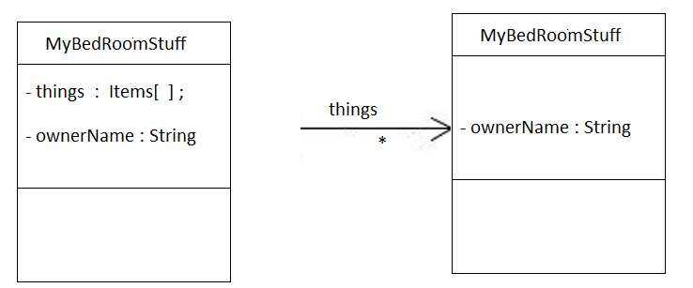
IMPORTANT UML Notation
These two UMLs are IDENTICAL.
- the one on the left displays the things array as an instance variable
- the one on the right displays the things array and it’s unlimited size on top
of the association arrow, BUT realize that the left diagram means the exact same as the right diagram.

Slide 3
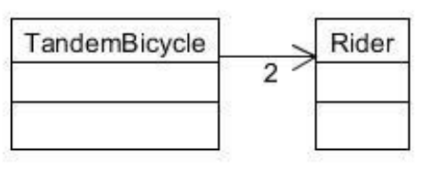
IMPORTANT UML Notation
Read this as, “TandemBicycle has 2 Riders”
public class TandemBicycle
{
Rider r1, r2;
}
public class Rider {
}

Slide 4
1. Static Class Variables
What is output to the terminal screen?
public class Locker
{
private int lockerNumber;
private static int nextId;
public Locker()
{
if (nextId <= 0)
nextId = 100;
else
nextId++;
lockerNumber = nextId;
}
public String toString() {
return String.format("%d",lockerNumber);
}
}
public class TestProgram
{
public static void main(String[] args) {
Locker a,b,c;
a = new Locker();
b = new Locker();
c = new Locker();
System.out.println(c);
}
}

Slide 5
1. Static Class Variables
What is output to the terminal screen?
102
public class Locker
{
private int lockerNumber;
private static int nextId;
public Locker()
{
if (nextId <= 0)
nextId = 100;
else
nextId++;
lockerNumber = nextId;
}
public String toString() {
return String.format("%d",lockerNumber);
}
}
public class TestProgram
{
public static void main(String[] args) {
Locker a,b,c;
a = new Locker();
b = new Locker();
c = new Locker();
System.out.println(c);
}
}

Slide 6
2. Switch Statement
Suppose: int day = 4;
Output the day number and the 3 letter day of the
week using a switch statement, e.g. 0-Sun and 6-Sat.
4-Thu

Slide 7
2. Switch Statement
Suppose: int day = 4;
Output the day number and the 3 letter day of the
week using a switch statement, e.g. 0-Sun and 6-Sat.
4-Thu
int day = 4;
String sDay = "";
switch (day) {
case 0:
sDay="Sun";
break;
case 1:
sDay="Mon";
break;
case 2:
sDay="Tue";
break;
case 3:
sDay="Wed";
break;
case 4:
sDay="Thu";
break;
case 5:
sDay="Fri";
break;
case 6:
sDay="Sat";
break;
default:
sDay=“Err”;
}
System.out.println(day + "-" + sDay);

Slide 8
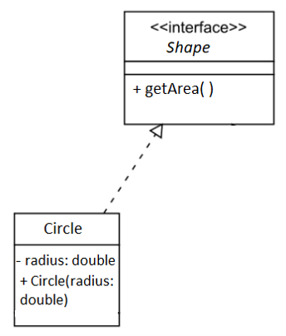
3. Interfaces
What’s wrong with the UML diagram, what
is the UML diagram missing?
Write the correct Java code for this diagram.

Slide 9
3. Interfaces
What’s wrong with the UML?
Write the correct Java code for this diagram.
public interface Shape
{
public double getArea( );
}
Compliance with the interface demands that the Circle class must have
a public getArea( ) method
public class Circle implements Shape
{
private double radius;
public Circle(double radius) {
this.radius = radius;
}
public double getArea( ) {
return Math.PI * radius * radius;
}
}

Slide 10
R4. ArrayList
Write the Java code which will declare and create an array called, numbers which holds the numbers: 4.5, 5.5 and 6.5. Output the array as shown on the terminal window.
[4.5, 5.5, 6.5]

Slide 11
4. ArrayList
Write the Java code which will declare and create an arraylist called, numbers which holds the numbers: 4.5, 5.5 and 6.5. Output the array as shown on the terminal window.
import java.util.ArrayList;
public class TestProgram
{
public static void main(String[] args) {
ArrayList<double> numbers = new ArrayList<>();
numbers.add(4.5);
numbers.add(5.5);
numbers.add(6.5);
System.out.println(numbers);
}
}
[4.5, 5.5, 6.5]
Oops!! …there’s something
wrong with this answer.
CAN YOU FIND THE ERROR?

Slide 12
4. ArrayList
Write the Java code which will declare and create an arraylist called, numbers which holds the numbers: 4.5, 5.5 and 6.5. When the program is run the output is shown on the terminal window.
import java.util.ArrayList;
public class TestProgram
{
public static void main(String[] args) {
ArrayList<Double> numbers = new ArrayList<>();
numbers.add(4.5);
numbers.add(5.5);
numbers.add(6.5);
System.out.println(numbers);
}
}
[4.5, 5.5, 6.5]
MAJOR ISSUE:
In Java, ArrayList stores object references rather than the actual objects
themselves. This applies to all Java collections.
When you add an element to an ArrayList, it stores a reference to the object
you added, not a copy of the object's data. YOU CAN NOT STORE primitive types
like, int, double, boolean or char in an ArrayList. Use their corresponding
primitive wrapper instead! (i.e. Integer, Double, Boolean or Char )

Slide 13
5. Catching and Throwing Unchecked Exceptions
Study the program below, it crashes with an ArrayIndexOutOfBoundsException. It does however display
“Error: index out of bounds” to the terminal window before it crashes. CAN YOU FIX THE PROGRAM SO IT
DOESN’T CRASH, and STILL DISPLAYS THE SAME ERROR TO THE TERMINAL WINDOW?
public class ExceptionExample {
public static void main(String[] args) {
int[] numbers = { 1, 2, 3, 4, 5 };
int index = 10;
int result = getElementAt(numbers, index);
System.out.println("Element at index " + index + ": " + result);
}
public static int getElementAt(int[] arr, int index) {
if (index < 0 || index >= arr.length) {
System.out.println(“Error: index out of bounds”);
}
return arr[index];
}
}
you will need to catch the
exception
you’re going to have to remove
This line and replace it with
something else

Slide 14
5. Catching and Throwing Unchecked Exceptions
Study the program below, it crashes with an ArrayIndexOutOfBoundsException. It does however display
“Error: index out of bounds” to the terminal window before it crashes. CAN YOU FIX THE PROGRAM SO IT
DOESN’T CRASH, and STILL DISPLAYS THE SAME ERROR TO THE TERMINAL WINDOW?
public class ExceptionExample {
public static void main(String[] args) {
try {
int[] numbers = { 1, 2, 3, 4, 5 };
int index = 10;
int result = getElementAt(numbers, index);
System.out.println("Element at index " + index + ": " + result);
} catch (ArrayIndexOutOfBoundsException e) {
System.out.println("Caught an exception: " + e.getMessage());
}
}
public static int getElementAt(int[] arr, int index) {
if (index < 0 || index >= arr.length) {
throw new ArrayIndexOutOfBoundsException(" Error: index out of bounds”);
}
return arr[index];
}
}
CATCH EXCEPTION
THROW EXCEPTION

Slide 15
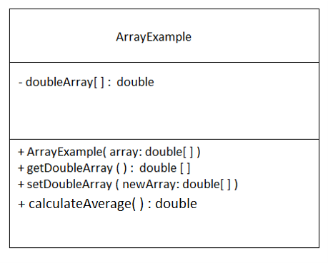
6. Built-In Arrays & Going from UML->Code
Code the following class into Java
so that the main pgm below works.
(no need for exceptions)
public static void main(String[] args) {
double[] exampleArray = { 3.5, 2.0, 9.8, 1.2, 6.4 };
ArrayExample example = new ArrayExample(exampleArray);
System.out.println("Original Array:");
for (double num : example.getDoubleArray()) {
System.out.print(num + " ");
}
System.out.println("\nAverage: " + example.calculateAverage());
}

Slide 16
6. Built-In Arrays & Going from UML->Code
public class ArrayExample {
private double[ ] doubleArray;
public ArrayExample(double[ ] array) {
// Constructor to initialize the instance variable
doubleArray = array;
}
public double[ ] getDoubleArray() {
return doubleArray;
}
public void setDoubleArray(double[ ] newArray) {
doubleArray = newArray;
}
public double calculateAverage() {
// Calculate and return the average
if (doubleArray.length == 0) {
return 0.0; // Handle the case when the array is empty
}
double sum = 0.0;
for (double num : doubleArray) {
sum += num;
}
return sum / doubleArray.length;
}

Slide 17
7. One-liners
a. What’s the line that a button, called GoButton uses to trigger a handler routine called, goButtonTask
GoButton.setOnAction( this:: goButtonTask );
b. What’s the line that declares and populates a 1-d built-in integer array with values, 3, 9 & 27
int[ ] numbers = { 3, 9, 27 } ;
What’s the line that triggers a routine called, pressHander to run in a canvas called, “c”,
after the primary mouse button is pressed?
c.addEventHandler(MouseEvent.MOUSE_PRESSED, this::pressHandler);
d. What’s the line which will declare an String arraylist called, A.
ArrayList<String> A = new ArrayList<String>( );
or
ArrayList<String> A = new ArrayList<>( );

Slide 18
7. One-liners
e. What’s the first line of a method handler, called goButtonTask, which will run if triggered by the line
GoButton.setOnAction( this:: goButtonTask );
public void goButtonTask ( ActionEvent e ) {
}
What’s the first line of the method hander, called pressHander, which will run if triggered by
canvas.addEventHandler(MouseEvent.MOUSE_PRESSED, this::pressHandler);
public void pressHandler( MouseEvent me ) {
}
What’s the if statement condition, when you compare two strings, s1 and s2 for equality. Why can’t you use
== sign?
if ( s1.equals(s2) ) {
//you can’t use the == because s1 and s2 are reference addresses that point to the
// string values, Always use a method when comparing two objects.
}

Slide 19
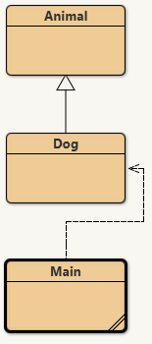
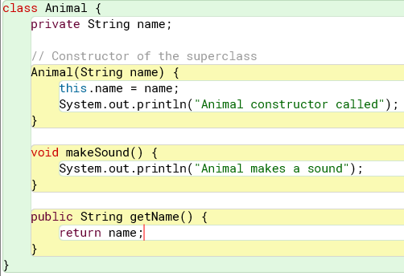
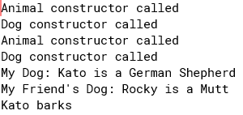
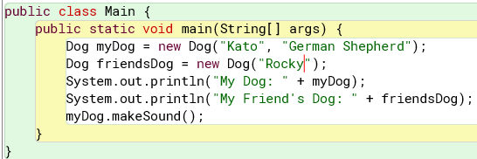
8. super( ) and this ( ) - Inheritance
Study the code below, and write the Dog class, so that the product shot is realized exactly
when the main method below is run.

Slide 20
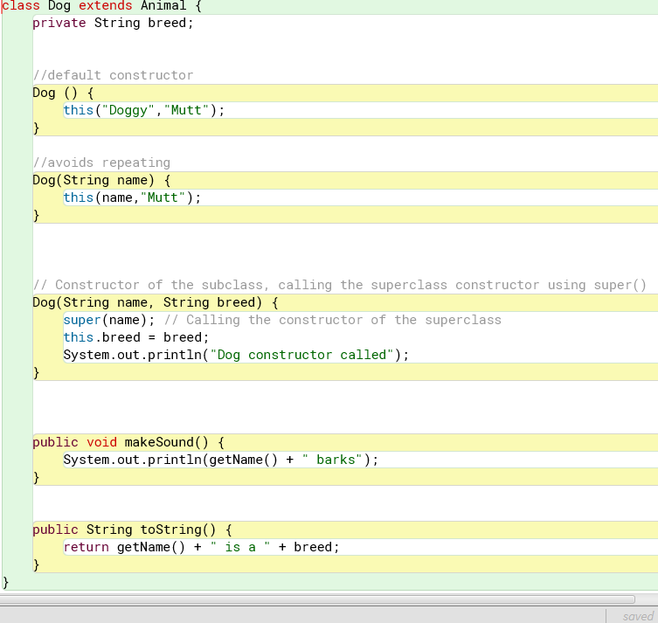
8. super( ) and this ( ) - Inheritance
Study the code below, and write the Dog class, so that the product shot is realized exactly
when the main method is run.
Code the most complicated constructor
first, i.e. the one with the most parameters
…then just call the most complicated
Constructor; this will avoid duplicate code

Slide 21
9a. For Loops
Study the main program below and write from scratch the Employee class and then display
to the terminal windows the list of employees and their current hourly wage in the EXACT format below..
public class Main
{
public static void main(String args[]) {
//Creating a list of employees
ArrayList<Employee> myPeople =new ArrayList<>();
myPeople.add(new Employee("Jin",15.00));
myPeople.add(new Employee("Bashshar",17.00));
myPeople.add(new Employee("Chris",19.00));
//traversing the employees using an enhanced for loop
for(Employee e : myPeople){
System.out.println(e);
}
}
}

Slide 22
9a. For Loops
Study the main program below and write from scratch the Employee class and then display
to the terminal windows the list of employees and their current hourly wage in the EXACT format below..
public class Main
{
public static void main(String args[]) {
//Creating a list of employees
ArrayList<Employee> myPeople =new ArrayList<>();
myPeople.add(new Employee("Jin",15.00));
myPeople.add(new Employee("Bashshar",17.00));
myPeople.add(new Employee("Chris",19.00));
//traversing the employees using an enhanced for loop
for(Employee e : myPeople){
System.out.println(e);
}
}
}
public class Employee {
private String name;
private double wage;
public Employee(String name, double startingWage) {
this.name = name;
this.wage = startingWage;
}
public String toString() {
return String.format("%-10s $%.2f / hr",name,wage);
}
}

Slide 23
9b. For Loops (using only ENHANCED for loops – answering this question.)
Add a method to Employee to allow for wage increases, i.e. payRaise( double amount) .
In the main program, give everyone a 50 cent raise.
public class Main
{
public static void main(String args[]) {
//Creating a list of employees
ArrayList<Employee> myPeople =new ArrayList<>();
myPeople.add(new Employee("Jin",15.00));
myPeople.add(new Employee("Bashshar",17.00));
myPeople.add(new Employee("Chris",19.00));
//traversing the employees using an enhanced for loop
for(Employee e : myPeople){
System.out.println(e);
}
}
}
public class Employee {
private String name;
private double wage;
public Employee(String name, double startingWage) {
this.name = name;
this.wage = startingWage;
}
public String toString() {
return String.format("%-10s $%.2f / hr",name,wage);
}
}

Slide 24
9b. For Loops (using only ENHANCED for loops – answering this question.)
Add a method to Employee to allow for wage increases, i.e. payRaise( double amount) .
In the main program, give everyone a 50 cent raise.
public class Main
{
public static void main(String args[]) {
//Creating a list of employees
ArrayList<Employee> myPeople =new ArrayList<>();
myPeople.add(new Employee("Jin",15.00));
myPeople.add(new Employee("Bashshar",17.00));
myPeople.add(new Employee("Chris",19.00));
for(Employee e : myPeople){
e.payRaise(0.50);
}
//traversing the employees using an enhanced for loop
for(Employee e : myPeople){
System.out.println(e);
}
}
}
public class Employee {
private String name;
private double wage;
public Employee(String name, double startingWage) {
this.name = name;
this.wage = startingWage;
}
public void payRaise(double amount) {
wage = wage + amount;
}
public String toString() {
return String.format("%-10s $%.2f / hr",name,wage);
}
}

Slide 25
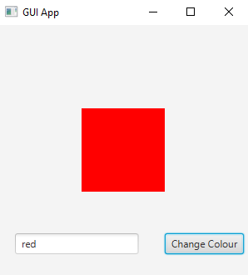
10. GUI programming
Code into Java this GUI App.
Use the standard Java class Rectangle to handle the rectangle.
import javafx.scene.shape.Rectangle;
public void start(Stage stage) throws Exception {
Pane root = new Pane();
Scene scene = new Scene(root, 300, 300);
stage.setTitle("GUI App");
stage.setScene(scene);
// Create the model
// Specify x, y, width, and height
rectangle = new Rectangle(100, 100, 100, 100);

Slide 26
10. GUI programming
public void start(Stage stage) throws Exception {
Pane root = new Pane();
Scene scene = new Scene(root, 300, 300);
stage.setTitle("GUI App");
stage.setScene(scene);
// Create the model
rectangle = new Rectangle(100, 100, 100, 100);
// Create the GUI components
Canvas c = new Canvas(300, 300);
gc = c.getGraphicsContext2D();
button = new Button("Change Colour");
inputBox = new TextField("red");
// Add components to the root
root.getChildren().addAll(c, rectangle,button,inputBox);
// Configure the components (colors, fonts, size, location)
rectangle.relocate(100, 100);
rectangle.setFill(Color.BLUE); // Set fill color
inputBox.relocate(20,250);
button.relocate(200,250);
// Add Event Handlers and do final setup
button.setOnAction( this::colorHandler);
// Show the stage
stage.show();
}
public class GUIApp extends Application {
private Rectangle rectangle;
private GraphicsContext gc;
private TextField inputBox;
private Button button;
public void colorHandler( ActionEvent e) {
String str = inputBox.getText();
rectangle.setFill( Color.valueOf(str) );
}
Be sure you can
write the code
shown in green.

Slide 27
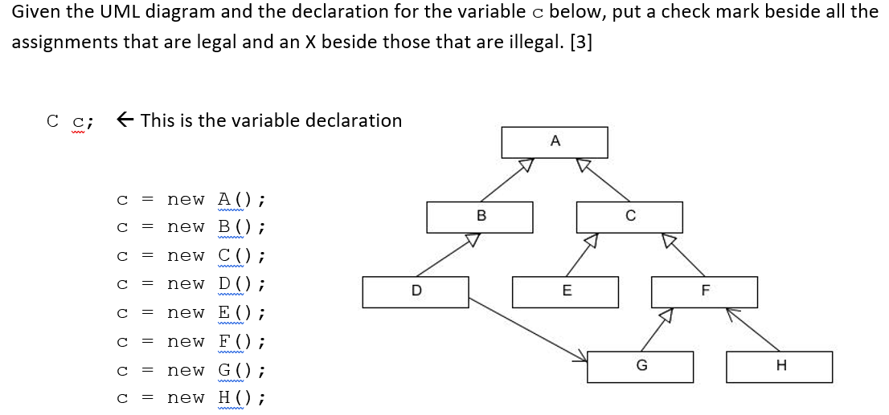
11 - Inheritance

Slide 28
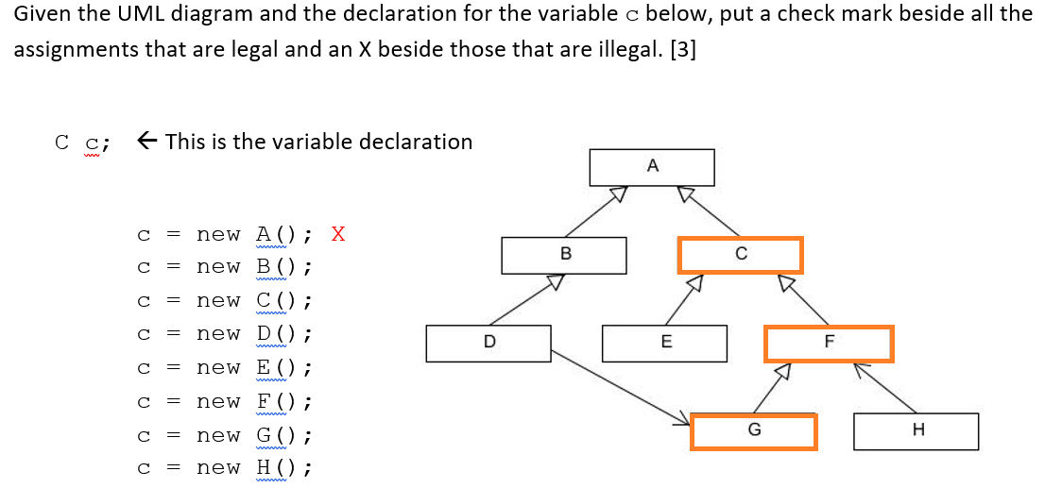
11 - Inheritance

Slide 29
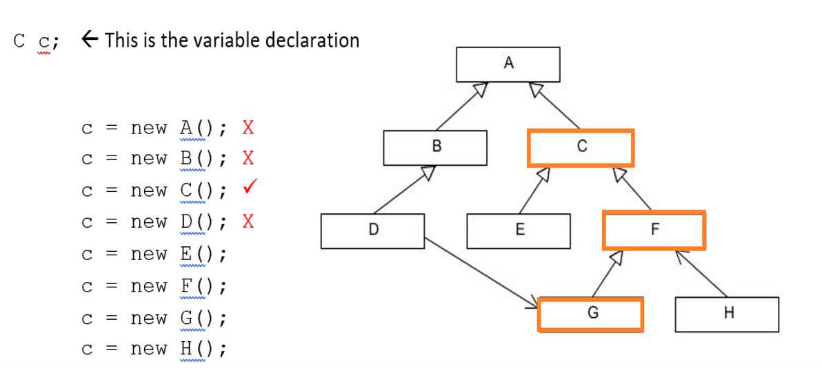
11 - Inheritance

Slide 30
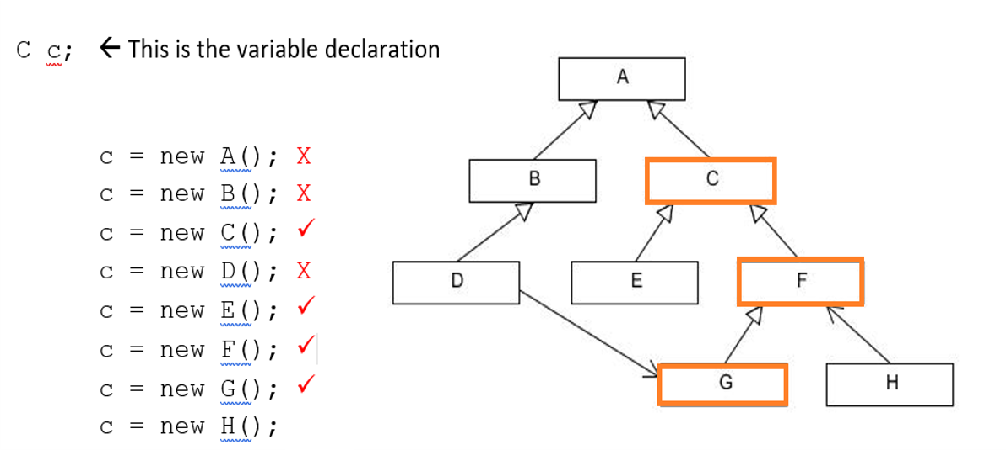
11 - Inheritance

Slide 31
11 - Inheritance

Slide 32
Write the java code for a setRadius(int radius) method
Which accepts only a POSITIVE integer value greater than
ZERO for the radius. If the radius supplied is less than
or equal to 0, throw an BadRadiusException with a message,
"Radius must be >= 0"

Slide 33
Write the java code for a setRadius(int radius) method
Which accepts only a POSITIVE integer value greater than
ZERO for the radius. If the radius supplied is less than
or equal to 0, throw an BadRadiusException with a message,
"Radius must be >= 0"
public void setRadius(int radius)
{
if (radius <= 0) {
throw new BadRadiusException(“Radius must be >= 0”)
this.radius = radius;
}
}

Slide 34
13. Write a main program which uses the Scanner to ask the user for his/her age.
Store the age received in a integer variable called, age. If the user enters a string
instead for the age, assign the age to 0 and output an appropriate error message
to the terminal window. . (use InputMismatchException)

Slide 35
13. Write a main program which uses the Scanner to ask the user for his/her age.
Store the age received in a integer variable called, age. If the user enters a string
instead for the age, assign the age to 0 and output an appropriate error message
to the terminal window. (use InputMismatchException)
public static void main(String [ ] args) {
int age = 0;
Scanner keybd = new Scanner(System.in);
try
{
age = keybd.nextInt( ) keybd.nextLine(); //clear the line
}
catch ( InputMisMatchException e )
{
System.out.println(“Error: age must be >= 0”);
age = 0;
}
}

Slide 36
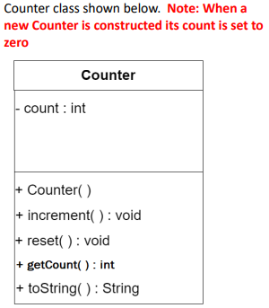
Write code that will create an array of 1000 Counter objects called, myCounters. Next, increment each
counter by a random integer between 0 and 100 inclusive. Then, display the current count of each counter
using an enhanced for loop. IMPORTANT: you may NOT add or change the Counter class in anyway!

Slide 37
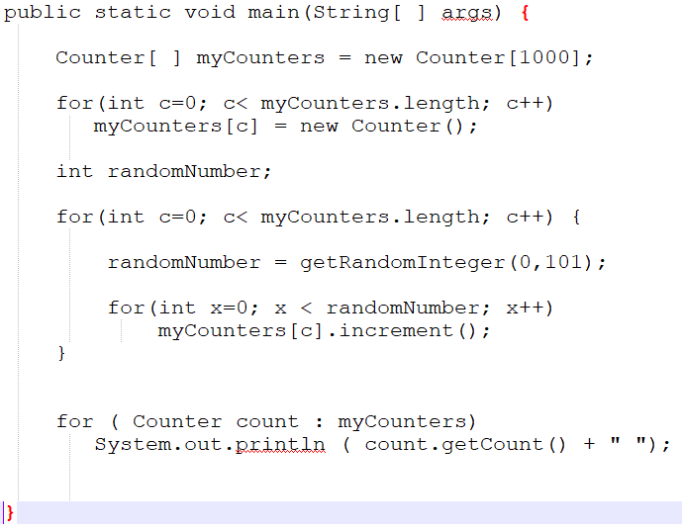
Write code that will create an array of 1000 Counter objects called, myCounters. Next, increment each
counter by a random integer between 0 and 100 inclusive. Then, display the current count of each counter
using an enhanced for loop. IMPORTANT: you may NOT add or change the Counter class in anyway!

Slide 38
Write a INTERFACE class which demands that all classes
compliant have a getArea() method.

Slide 39
Write a INTERFACE class which demands that all classes
compliant have a getArea() method.
public interface measureable ( ) {
public double getArea();
}

Slide 40
(following on from question 15), give an example of
the header line belonging to a class that obeys, measurable
public interface measureable ( ) {
public double getArea();
}

Slide 41
(following on from question 15), give an example of
the header line belonging to a Circle class that obeys,
measurable
public class Circle implements measurable {
//etc
}

