Slide 1
JAVA ARRAY Flash Cards
v120 by Dave Slemon

Slide 2
Q1. How would you explain
in plain English to a friend
what an array is.
Provide your friend with a
good analogy.

Slide 3
A1. How would you explain
in plain English to a friend
what an array is.
Imagine a street with houses on it.
Each house has its own unique
house number starting at “0”.
That’s what an array is.

Slide 4
Q2a. What’s another word for this?
[ ]

Slide 5
A2a. What’s another word for this?
[ ]
Array
All mean the same: built-in array, Python List, 1-dimensional array or Vector

Slide 6
Q2b. What’s another word for this?
[ ] [ ]

Slide 7
A2b. What’s another word for this?
[ ] [ ]
2-dimensional Array

Slide 8
Q2c. How do you read this?
int [ ] num;

Slide 9
A2c. How do you read this?
int [ ] num;
integer array num

Slide 10
Q2c. Instantiate a 1000 element integer array called, num.

Slide 11
A2. Instantiate a 1000 element integer array called, num.
int [ ] num = new int[1000];

Slide 12
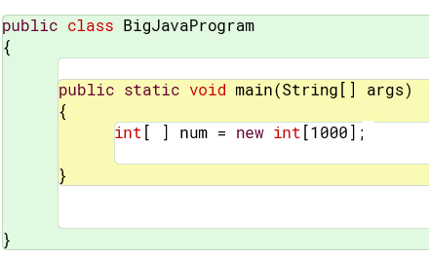
Recommended: type in the solutions to an ongoing big java program as you go along.
Start your BigJavaProgram now …..

Slide 13
Q3. Declare 4 primitive data types in Java and provide a value for each. Note primitive data types all start with a lowercase letter.

Slide 14
A3. Declare 4 primitive data types in Java and provide a value for each. Note primitive data types all start with a lowercase letter.
int x = 10;
long y = 1000000;
double pi = 3.14159;
boolean w = true;
char ch = ‘A’;

Slide 15
Q4. Using a property offered with built-in arrays, output the length of array, num

Slide 16
A4. Using a property offered with built-in arrays, output the length of array, num
//length of num array
System.out.println( num.length );

Slide 17
Q5. Declare a boolean array and then write a loop to initialize all 50 elements of the array, b below to: true. note: boolean arrays default to false.
boolean[ ] b = new boolean[50];

Slide 18
A5. Declare a boolean array and then write a loop to initialize all 50 elements of the array, b below to: true. note: boolean arrays default to false.
boolean[ ] b = new boolean[50];
for ( int i=0; i< 50; i++ ) b[i] = true;

Slide 19
Q6. When you declare a
String array and before you populate the array with values,
what value exists in each element?

Slide 20
A6. When you declare a
String array and before you populate the array with values, what value exists in each element? This is true for all objects, not just String
null

Slide 21
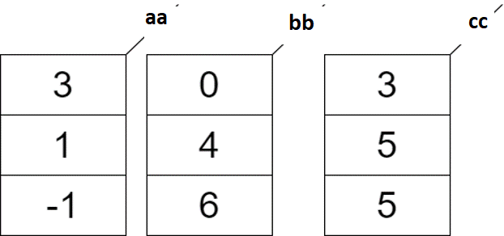
Q7. Add the corresponding values in arrays, aa & bb and place their sum in array cc for each corresponding cell.

Slide 22
A7.
int[ ] aa = { 3, 1, -1 };
int[ ] bb = { 0, 4, 6 };
int[ ] cc = new int[ aa.length ];
for(int i=0; i < aa.length; i++)
cc[i] = aa[i] + bb[i];

Slide 23
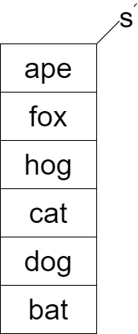
Q8a. Consider the String array, s.
Declare and populate the array and
Then display the following
sentence using array elements
where possible
The fox chased the cat

Slide 24
A8a
//The fox chased the cat
0
1
2
3
4
5
String[ ] s = {“ape”, ”fox”, ”hog”, ”cat”, ”dog”, ”bat”};
System.out.println (“The “ + s[1] + “ chased the “ + s[3] );

Slide 25
Q8b. Using an array property,
output the number of elements
in array, s

Slide 26
A8b. Using an array property,
output the number of elements
in array, s
System.out.println( s.length );

Slide 27
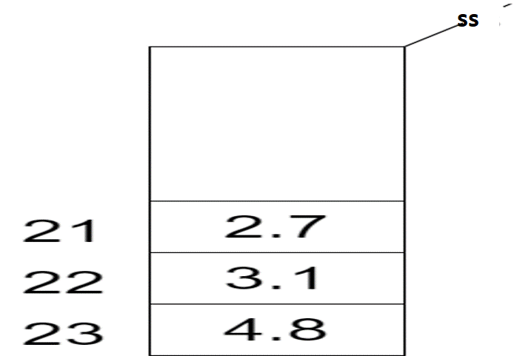
Q9a. Instantiate but don’t populate array, ss

Slide 28
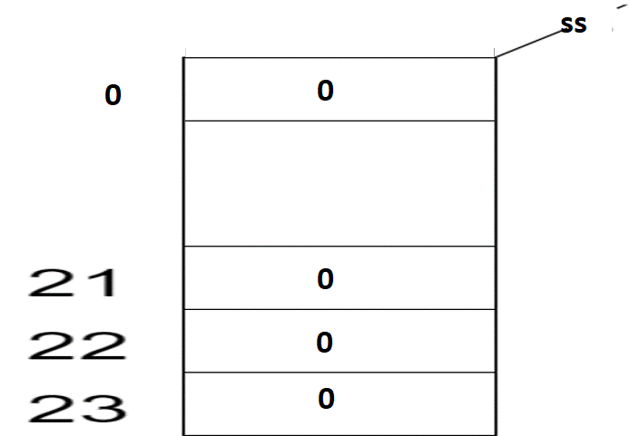
A9a. Instantiate but don’t populate array, ss
double [ ] ss = new double[24];
Note: all of the cells of the array will
default to 0

Slide 29
Q9b. Populate the last 3 values as shown

Slide 30
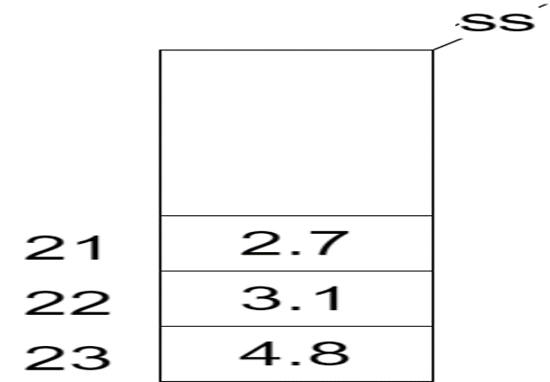
A9b. Populate the last 3 values as shown
ss[21] = 2.7; ss[22] = 3.1; ss[23] = 4.8;

Slide 31
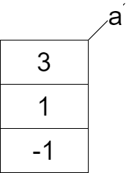
Q10. Instantiate and populate array, “a” in as few java code lines as possible.

Slide 32
A10. Instantiate and populate array, “a” in as few java code lines as possible.
int [ ] a = { 3, 1, -1 };

Slide 33
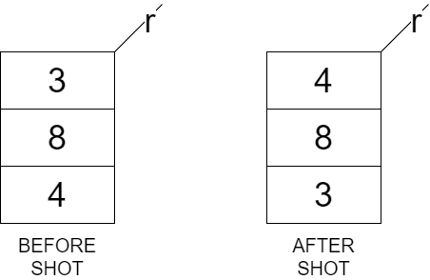
Q11. Declare and populate array ‘r’. Using a single variable, temp, switch the 3 and 4 values as shown
below in the
array r

Slide 34
Q11. Declare and populate array ‘r’. Using a single variable, temp, switch the 3 and 4 values as shown below in the array r
int[ ] r = {3, 8, 4};
int temp = r[0]; r[0] = r[2]; r[2] = temp;

Slide 35
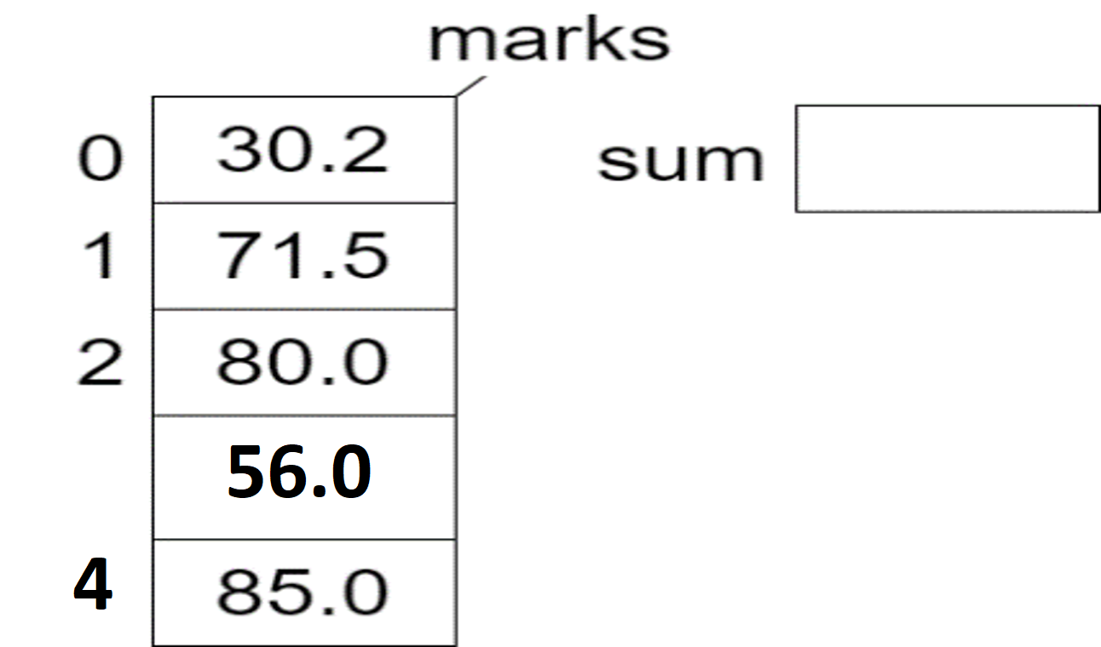
Q12a Declare and populate marks array, then write a loop to calculate and display the “sum” all of the entries in the
marks array.

Slide 36
A12a Declare and populate marks array, then write a loop to calculate and display the “sum” all of the entries in the
marks array.
double[ ] marks = {30.2, 71.5, 80.0, 56.0, 85.0};
double sum = 0.0;
for(int i=0; i < marks.length; i++) sum = sum + marks[i];
System.out.println (“Standard for sum = “ + sum);

Slide 37
Q12b Write an ENHANCED for loop to calculate and display the “sum” all of
the entries
in the
marks array.

Slide 38
A12b Write an ENHANCED for loop to calculate and display the “sum” all of
the entries
in the
marks array.
sum = 0.0;
for(double m : marks) sum = sum + m;
System.out.println(“Enhanced for sum = “ + sum);

Slide 39
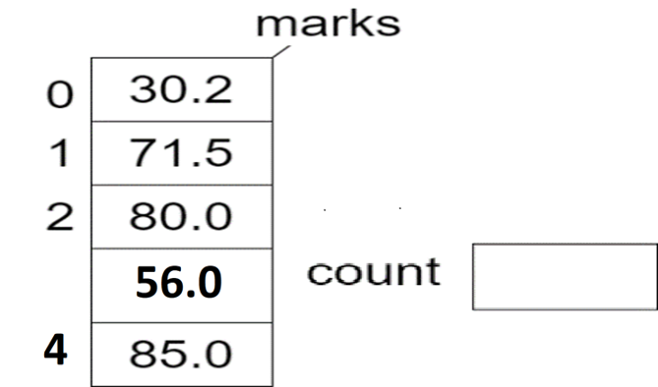
Q12b Write a loop to calculate and display “count” which is the number of entries where the array’s value is greater or
equal to 50.0

Slide 40
A12b Write a loop to calculate and display “count” which is the number of entries where the array’s value is greater or equal to 50.0
int count = 0;
for(int i=0; i < marks.length; i++) if (marks[i] >= 50.0) count = count + 1;
System.out.println("Standard for count = " + count); OR
for(double m : marks) if (m >= 50.0) count = count + 1;
System.out.println(“Enhanced for count = " + count);

Slide 41
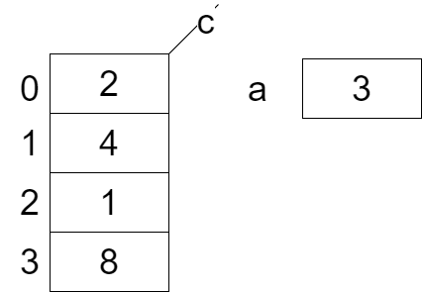
Q13 What is displayed if the following are output to the console?
c[2] _______
b) c[a] _______
c) c.length _____

Slide 42
A13 What is displayed if the following are output to the console?
c[2] ___1____
b) c[a] _______
c) c.length _____

Slide 43
A13 What is displayed if the following are output to the console?
c[2] ___1____
b) c[a] ___8____
c) c.length _____

Slide 44
A13 What is displayed if the following are output to the console?
c[2] ___1____
b) c[a] ___8____
c) c.length __4___

Slide 45
Q13 What is displayed if the following are output to the console?
d) c[a-1] ______
e) a + c[3] ______
f) c[0] + c[3] _______

Slide 46
A13 What is displayed if the following are output to the console?
d) c[a-1] ___1___
e) a + c[3] ______
f) c[0] + c[3] _______

Slide 47
A13 What is displayed if the following are output to the console?
d) c[a-1] ___1___
e) a + c[3] ___11___
f) c[0] + c[3] _______

Slide 48
A13 What is displayed if the following are output to the console?
d) c[a-1] ___1___
e) a + c[3] ___11___
f) c[0] + c[3] ___10____

Slide 49
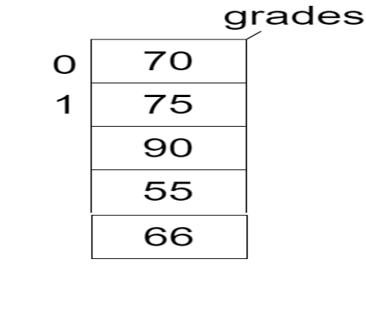
Q14 Instantiate and then calculate the average mark in the array of student grades. Assume the array is populated with grades.

Slide 50
A14
double[ ] grades = new double[5];
double sum=0.0, count = 0.0, avg = 0.0;
for(int i=0; i < grades.length; i++)
{
sum = sum + grades[i];
count = count + 1;
}
avg = 0.0;
if (count > 0.0)
avg = sum / count;

Slide 51
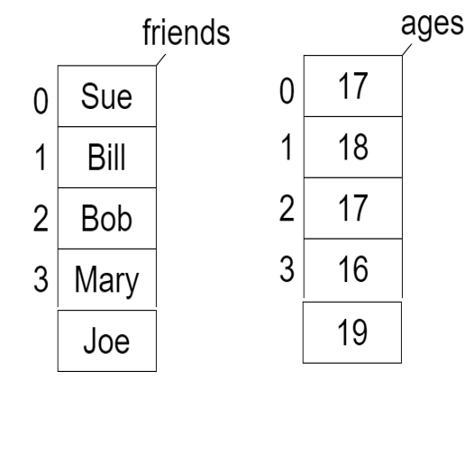
Q15 Instantiate a 5 element String array called, friends. Also create a 5 element integer array called, ages. Begin by populating the two arrays with this data.
For example, Sue’s age is 17
Write code which outputs your youngest friend(s) by name.

Slide 52
A15 Write code which outputs your youngest friend(s) by name.
String[ ] friends = {“Sue”,”Bill”,”Bob”,”Mary”,”Joe”}; int[ ] ages = {17,18,17,16,19};
//first find the youngest age
int youngest = 999;
for(int i=0; i < ages.length; i++)
if (ages[i] < youngest) youngest = ages[i];
//output all friends with the youngest age
for(int i=0; i < friends.length; i++)
if (ages[i] == youngest)
System.out.println(friends[i]);

Slide 53
Q15 The two arrays are populated with this data.
For example, Sue’s age is 17
b) Output the names of your friends who are exactly 19 year old.

Slide 54
A15b Output the names of your friends who are exactly 19 year old.
for(int i=0; i < friends.length; i++)
if (ages[i] == 19) System.out.println( friends[i] );

Slide 55
Q15c A year goes by, write code which increases the age of each friend by 1 year.

Slide 56
A15c A year goes by, write code which increases the age of each friend by 1 year.
for(int i=0; i < ages.length; i++) ages[i] = ages[i] + 1;

Slide 57
Q16 You have to store 3 colours into an array called, colours. The colours are #FFFFFF, #000000 and #DEDEDE.
Instantiate an array with an appropriate datatype and populate it with these 3 colours.

Slide 58
A16 You have to store 3 colours into an array called, colours. The colours are #FFFFFF, #000000 and #DEDEDE.
String [ ] colours = new String[3];
colours[0] = “#FFFFFF”; colours[1] = “#000000”; colours[2] = “#DEDEDE”;
(there’s also another better answer … can you guess what it may be?

Slide 59
A16 You have to store 3 colours into an array called, colours. There are #FFFFFF, #000000 and #DEDEDE.
import javafx.scene.paint.Color;
Color[ ] colours = new Color[3];
colours[0] = Color.web("#FFFFFF",1.0);
colours[1] = Color.web("#000000",1.0);
colours[2] = Color.web("#DEDEDE",1.0);

Slide 60
Note: The alpha value defines the transparency of a color and can be represented by a float value in the range [0.0,1.0] or [0,255]
colours[0] = Color.web("#FFFFFF",1.0);
colours[1] = Color.web("#000000",1.0);
colours[2] = Color.web("#DEDEDE",1.0);

Slide 61
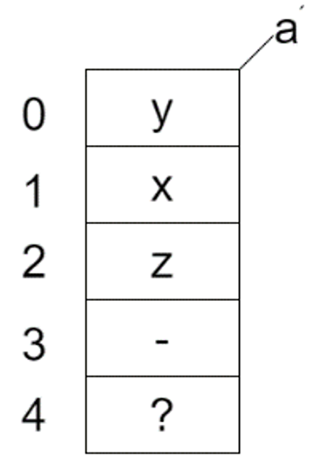
Q17 a) create the “a” array
(but do not populate it)
Note: remember when you create an array, the default value
for all elements is null

Slide 62
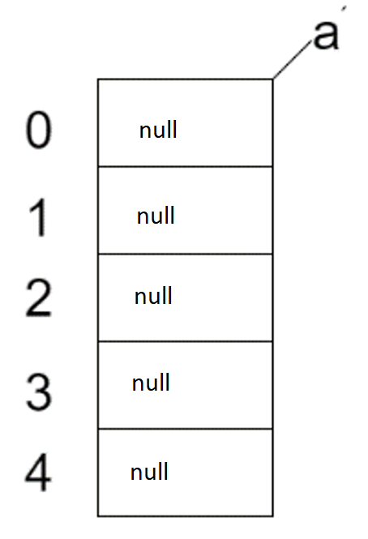
A17 a) instantiate the “a” array
(but do not populate
char [ ] a = new char[5];

Slide 63
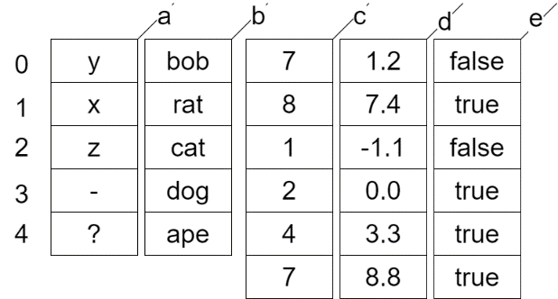
Q17 b) what would be displayed
b[4] _______ d[2] _________

Slide 64
A17 b) what would be displayed
b[4] __ape_____ d[2] _____

Slide 65
A17 b) what would be displayed
b[4] __ape_____ d[2] __-1.1___

Slide 66
Q17 c) what would be displayed
e[2] _______ d[ c[2] ] _________

Slide 67
A17 c) what would be displayed
e[2] __false___ d[ c[2] ] _____

Slide 68
A17 c) what would be displayed
e[2] __false___ d[ c[2] ] ___7.4__

Slide 69
Q18 Write a loop to subtract 1 from each value contained in the “c” array

Slide 70
A18 Write a loop to subtract 1 from each element of the “c” array
for(int i=0; i< c.length; i++) c[i] = c[i] – 1;

Slide 71
Q19 Output how many “true” values exist in the “e” array

Slide 72
A19 Output how many “true” values exist in the “e” array
int count = 0; for(int i=0; i< e.length; i++) if ( e[i] ) count++; System.out.println(count);

Slide 73
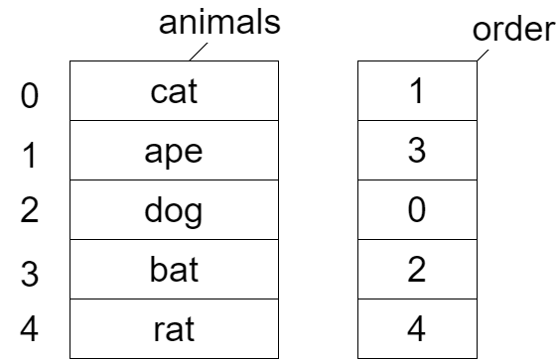
Q21 Begin by creating the animals and order arrays with the exact values shown . The integer order array is populated in such a way that its values are the subscripts belonging to the animals array such that it puts the animals array in alphabetical order.
Write a for loop
which prints the
animal names
out in alphabetical
order.

Slide 74
A21 Write a for loop which prints the animal names
out in alphabetical order.
String [ ] animals = {“cat”,”ape”,”dog”,”bat”,”rat”};
int [ ] order = {1,3,0,2,4};
int index = 0;
for (int i=0; i< order.length; i++) {
index = order[i];
System.out.println( animals[index] );
}

Slide 75
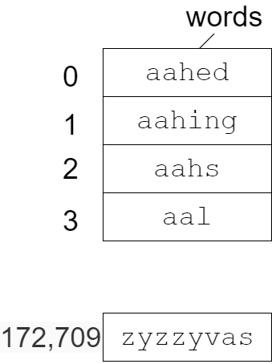
Q22 The array words contains every word in the dictionary, i.e. all 172,710 of them. Write a loop which outputs ONLY the words which end in “ed”, for example, selected

Slide 76
String w = "";
int lastPos = 0;
for (int i=0; i < words.length; i++)
{
w = words[i];
lastPos = w.length() - 1;
if (w.charAt(lastPos-1) == ‘e’ && w.charAt(lastPos) == 'd' )
System.out.println(w);
}

Slide 77
Q24 Copy each letter from the secretWord into a char array. Output the char array with two spaces between each letter both forwards and backwards in lower case, then output
the number of vowels, i.e. aeiou String secretWord = “HALLOWEEN”
h a l l o w e e n
n e e w o l l a h
Vowels = 4

Slide 78
char[ ] ch = new char[ secretWord.length( ) ];
int vowels = 0;
for(int c=0; c < secretWord.length( ); c++) {
ch[c] = secretWord.toLowerCase().charAt(c);
if (ch[c] == ‘a’ || ch[c] == ‘e’ || ch[c] == ‘i’ || ch[c] == ‘o’ || ch[c] == ‘u’) vowels++;
}
//forwards
for(int i=0; i < ch.length; i++)
System.out.print ( ch[i] + “ “ );
System.out.println();
A24 h a l l o w e e n
n e e w o l l a h
Vowels = 4
//backwards
for(int i=ch.length-1; i >= 0; i--)
System.out.print ( ch[i] + “ “ );
System.out.println();
System.out.println(“Vowels = “+vowels);

Slide 79
char[ ] ch;
ch = secretWord.toCharArray( );
//forwards
for(int i=0; i < ch.length; i++)
System.out.print ( ch[i] + “ “ );
System.out.println();H
Here’s a simpler way
A24 h a l l o w e e n
n e e w o l l a h
Vowels = 4
//backwards
for(int i=ch.length-1; i >= 0; i--)
System.out.print ( ch[i] + “ “ );
System.out.println();
System.out.println(“Vowels = “+vowels);

Slide 80
Q25 What is display if the following program is executed?
public static void main()
{
int[] ch = {1,2,1,2,1,2,1,0,0}; int amount = 0; for(int j = ch.length - 1; j > 0; j--) amount = amount + ch[j];
System.out.println("amount: " + amount);
}

Slide 81
A25 What is display if the following program is executed?
public static void main()
{
int[] ch = {1,2,1,2,1,2,1,0,0}; int amount = 0; for(int j = ch.length - 1; j > 0; j--) amount = amount + ch[j];
System.out.println("amount: " + amount);
}
amount: 9

Slide 82
Q26 In the array below, output any value within the array that repeats? A value in the array can only repeat at most ONCE.
for example, Original: 1 2 3 5 5 7 8 8 9 9 2
Repeats: 2 5 8 9

Slide 83
A26 In the array below output any value within the array that repeats? A value in the array can only repeat ONCE.
public static void main()
{
int[] A = {1,2,3,5,5,7,8,8,9,9,2};
//output the original
System.out.print("Original: ");
for(int i=0; i< A.length; i++)
System.out.printf("%d ", A[i] );
System.out.println();
Original: 1 2 3 5 5 7 8 8 9 9 2
Repeats: 2 5 8 9
System.out.print("Repeats: ");
for(int i=0; i< A.length; i++) {
for(int j=i+1; j < A.length; j++) {
if ( A[i] == A[j] ) {
System.out.printf("%d ", A[i] );
}
}
}
System.out.println();
}

Slide 84
Q27 Separate the 1s and 0s from the array below.
public static void main()
{
int[] nums = {0,1,0,0,1,1,1,0,1,0};
System.out.print("Original: ");
for(int i=0; i< nums.length; i++)
System.out.printf("%d ",nums[i]);
System.out.println();
}
sample output, Original: 0 1 0 0 1 1 1 0 1 0
Separated: 0 0 0 0 0 1 1 1 1 1

Slide 85
A27 Separate the 1s and 0s from the array below.
public static void separate(int[] nums)
{
//count number of 0s
int zeros = 0;
for(int i=0; i< nums.length; i++)
if (nums[i] == 0) zeros++;
for(int i=0; i< zeros; i++)
nums[i] = 0;
for(int i=zeros; i< nums.length; i++)
nums[i] = 1;
}
public static void main() {
int[] nums = {0,1,0,0,1,1,1,0,1,0};
System.out.print("Original: ");
for(int i=0; i< nums.length; i++)
System.out.printf("%d ",nums[i]);
System.out.println();
separate(nums);
System.out.print("Separated: ");
for(int i=0; i< nums.length; i++)
System.out.printf("%d ",nums[i]);
System.out.println();
}

Slide 86
Q28 Instantiate an array called “c”, of Circle to 10 elements.
Then draw a picture of this array.

Slide 87
A28 Instantiate an array called, “c” of Circle to 10 elements. Then draw a picture of this array.
Circle [ ] c = new Circle [10];
c
0
null
1
null
;
;
9
null

Slide 88
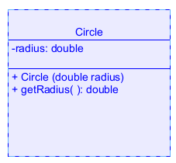
Q29 Assume the Circle class has a constructor which accepts the radius of the circle. Populate the array c, with 10 circles with a radius of 2.
Circle [ ] c = new Circle [10];
c
0
null
1
null
;
;
9
null

Slide 89
A29 Assume the Circle class has a constructor which accepts the radius of the circle. Populate the array c, with 10 circles with a radius of 2.
Circle [ ] c = new Circle [10];
c
0
for(int i = 0; i < c.length; i++)
c[ i ] = new Circle(2);
1
;
;
9

Slide 90
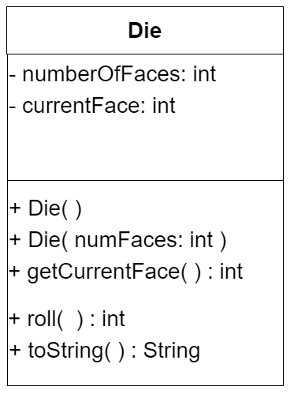
Q30 Assume the Dice class has a constructor which specifies the number of faces a die has. Populate the array dice, with 5 six-sided dice.
c
0
null
1
null
;
;
4
null

Slide 91
A30 Assume the Dice class has a constructor which specifies the number of faces a die has. Populate the array dice, with 5 six-sided dice.
dice
Dice [ ] dice = new Dice [5];
0
for(int i = 0; i < dice.length; i++)
{
dice[ i ] = new Dice(6);
}
1
;
;
4

Slide 92
Q31 Write a single Java statement to declare and create an array of 5 integers without specifying values to those integers.

Slide 93
A31 Write a single Java statement to declare and create an array of 5 integers without specifying values to those integers.
int[ ] a = new int[5];

Slide 94
Q32 Write a single Java statement to declare and create an array containing the following 3 strings, “Bat”, “Bee”, “Bug”

Slide 95
A32 Write a single Java statement to declare and create an array containing the following 3 strings, “Bat”, “Bee”, “Bug”
String[ ] a = { “Bat”, “Bee”, “Bug”} ;

Slide 96
Q33 Write a single Java statement to print the length of an array named, a.
Write a statement to print the 3rd element of an array named, a

Slide 97
A33 Write a single Java statement to print the length of an array named, a.
System.out.println (a.length);
Write a statement to print the 3rd element of an array named, a
System.out.println ( a[2] );

Slide 98
Q34 Suppose you have a variable named passengers which stores an array of objects of type Passenger. Write a statement which calls the getName() method for the first Passenger object in the passengers array.
Passenger
+ getName( ): String
+ setName (name: String)

Slide 99
A34 Suppose you have a variable named passengers which stores an array of objects of type Passenger. Write a statement which calls the getName() method for the first Passenger object in the passengers array.
Passenger
System.out.println( passengers[0].getName( ) );
+ getName( ): String
+ setName (name: String)

Slide 100
Q35 Using the passengers variable, write an enhanced for loop to set the name of every Passenger object in the array to “Sally”
Passenger
+ getName( ): String
+ setName (name: String)

Slide 101
A35 Using the passengers variable, write an enhanced for loop to set the name of every Passenger object in the array to “Sally”
for ( Passenger p: passengers ) {
p.setName(“Sally”);
}
Passenger
+ getName( ): String
+ setName (name: String)

