Slide 1
Java Strings
v103
By Dave Slemon

Slide 2
String Static Methods - length()
public static void main (String[] args)
{ //main
String phrase = "Mohawk College";
//index numbers
System.out.println( phrase );
System.out.println("01234567890123" );
System.out.println(" length: " + phrase.length() );
} //main

Slide 3
String Static Methods - the + sign
// + sign means concatenation
String phrase = "Mohawk College";
System.out.println(phrase + "\n" + "Department of Computer Science");
}

Slide 4
String Static Methods - toUpperCase( )
public static void main (String[] args)
{ //main
String phrase = "Mohawk College";
//index numbers
System.out.println( phrase );
System.out.println("01234567890123" );
//upper case
System.out.println(phrase.toUpperCase() );
} //main

Slide 5
String Static Methods - contains( )
public static void main (String[] args)
{ //main
String phrase = "Mohawk College";
//index numbers
System.out.println( phrase );
System.out.println("01234567890123" );
//contains
System.out.println(phrase.contains("w") );
System.out.println(phrase.contains("Academy") );
} //main

Slide 6
String Static Methods - charAt()
public static void main (String[] args)
{ //main
String phrase = "Mohawk College";
//index numbers
System.out.println( phrase );
System.out.println("01234567890123" );
//character index number
System.out.println( phrase.charAt(4) );
} //main

Slide 7
String Static Methods - indexOf()
public static void main (String[] args)
{ //main
String phrase = "Mohawk College";
//index numbers
System.out.println( phrase );
System.out.println("01234567890123" );
//index number
System.out.println( phrase.indexOf("w") );
} //main

Slide 8
String Static Methods - lastIndexOf( )
public static void main (String[] args)
{ //main
String phrase = "Mohawk College";
//index numbers
System.out.println( phrase );
System.out.println("01234567890123" );
//last index number
System.out.println( phrase.lastIndexOf("o") );
} //main

Slide 9
String Static Methods - substring( )
public static void main (String[] args)
{ //main
String phrase = "Mohawk College";
//index numbers
System.out.println( phrase );
System.out.println("01234567890123" );
//substring
System.out.println( phrase.substring(7) );
System.out.println( phrase.substring(2,6) );
} //main

Slide 10
String Static Methods - Combining Methods
public static void main (String[] args)
{ //main
String phrase = "Mohawk College";
//index numbers
System.out.println( phrase );
System.out.println("01234567890123" );
//combining methods
System.out.println(phrase.substring(2,6).length( ) );
} //main

Slide 11
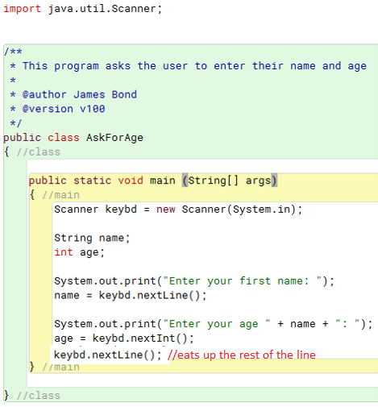
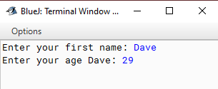
Getting User Input into a Variable
1. Attach the Scanner library
2. Create keybd object of type Scanner
3. Read a string than an integer.

Slide 12
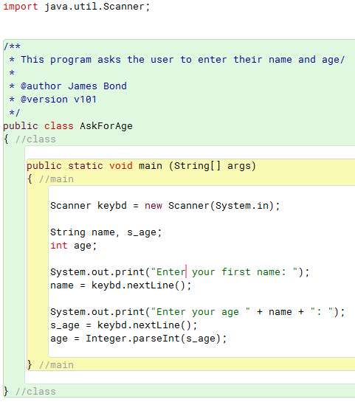
USER Input – it’s wise to read in initially as a String and then convert .., -- to prevent program crashes
…so the previous program is better written like this

Slide 13
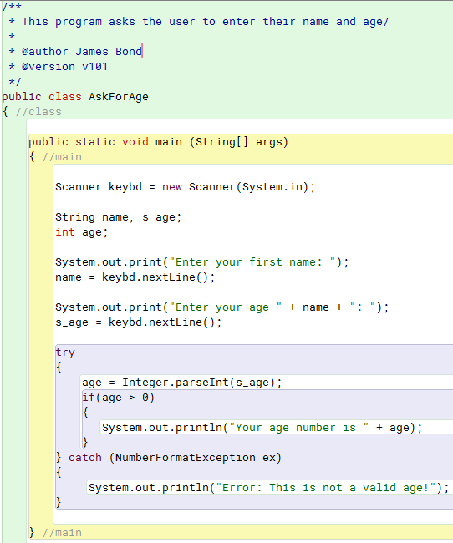
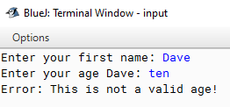
Data Validation
a try …. catch block can catch and deal with invalid user input

Slide 14
Primitive character literals are just a single character represented in single quotes.
char ch = 'c';
String literals are stored with double quotes. Strings are stored in memory as String objects and are written as a sequence of characters in double quotes.
String myName = new String("Bob");
or
String myName = "Bob";

Slide 15
There are a number of methods to compare String objects:
.equals ( ) s1.equals("hello”)
returns true if contents of the strings are equal
.equalsIgnoreCase ( ) s1.equalsIgnoreCase("hello")
ignores uppercase/lowercase differences
.compareTo ( ) s1.compareTo("hello")
returns 0 if strings are equal,
negative number if s1 is less than "hello“ alphabetically
positive number if s1 is greater than "hello"

Slide 16
The .substring( ) method creates a new String object by copying part of an existing String.
With one argument, copies from a starting index:
// 20
String letters = "abcdefghijklmnopqrstuvwxyz";
String newString = letters.substring(20); // "uvwxyz"
With two arguments, copies from index up to next index
// 3456
String letters = "abcdefghijklmnopqrstuvwxyz";
String newString2 = letters.substring(3, 6); // "def"

Slide 17
Method replace returns a new String object in which every occurrence of the first argument is replaced with the second.
// Can take char or String arguments
String newString = oldString.replace('x', 'y');
Method toUpperCase generates a new String with uppercase letters.
Method toLowerCase returns a new String object with lowercase letters.
String newString = oldString.toUpperCase();
Method trim generates a new String object that removes all whitespace characters that appear at the beginning or end.
Method toCharArray creates a new character array, a copy of the characters in the String.
char[] charArray = oldString.toCharArray();

