Slide 1
Java REVIEW Flashcards
Dave Slemon v101​

Slide 2
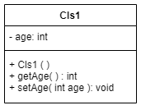
1. UML -> Code
Write the Java Code expressed in the UML below. The default age to 10.

Slide 3
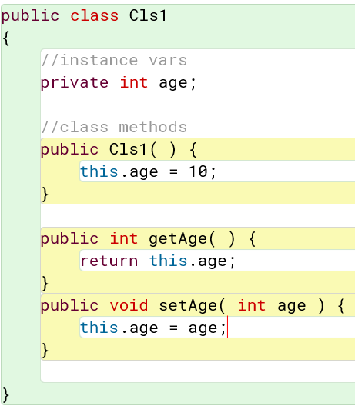
1. UML -> Code
Alternatively, you could initialize age private int age = 10;
and then leave the constructor with no
lines.
Write the Java Code expressed in the UML below.
Initialize the default age to 10.

Slide 4
2. Error Detection
Why does this program fail to run as intended?
public class Example {
public static void main(String[] args) {
int x = 10;
if (x > 5) {
int y = 20;
}
System.out.println(y);
System.out.println(x);
}
}

Slide 5
2. Error Detection
Why does this program fail to run as intended?
public class Example {
public static void main(String[] args) {
int x = 10;
if (x > 5) {
int y = 20;
}
System.out.println(y); // y is out of scope here
System.out.println(x);
}
}
To fix: move int y; up to the top of the main program
and change line inside the if to, y = 20;

Slide 6
3. JAVAFX
Draw a radius=50px circle with a black outline and a red interior. Position the circle exactly in the middle of a canvas which is 300 x 300. (don’t use the Circle class, use basic javafx drawing tools).
Recall:
void strokeOval(double topX, double topY, double width, double height)
void fillOval(double topX, double topY, double width, double height)

Slide 7
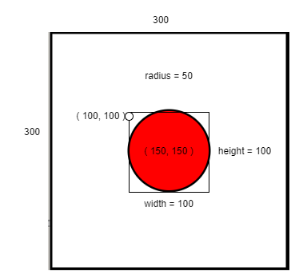
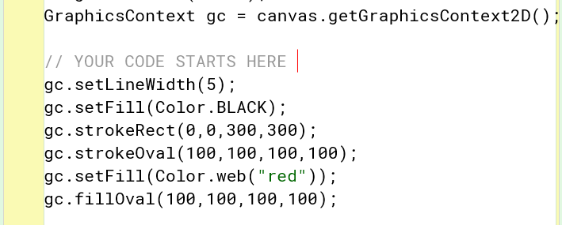
3. JAVAFX
Recall:
void strokeOval(double topX, double topY, double width, double height)
void fillOval(double topX, double topY, double width, double height)

Slide 8
4. ARRAYS
Write in one line the Java code to declare and populate a char array with all of the vowels, including y.

Slide 9
4. ARRAYS
Write in one line the Java code to declare and populate a char array with all of the vowels, including y.
char[ ] vowels = {'a','e','i','o','u','y' };

Slide 10
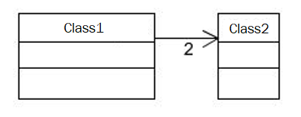
5. UML to CODE
Write the Java code which implements this UML diagram.

Slide 11
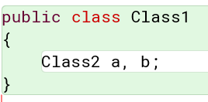
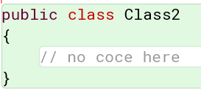
5. UML TO CODE
Write the Java code which implements this UML diagram.
It helps is you read the association arrow as “has a”:
“Class1 has 2 Class2s”

Slide 12
6a. DRAW A PICTURE
What would this line of code look like in RAM memory?
Circle [ ] c = new Circle[4];

Slide 13
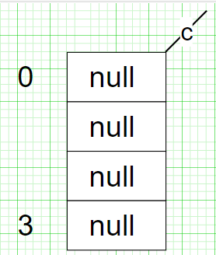
6a. DRAW A PICTURE
What would this line of code look like in RAM memory?
Circle [ ] c = new Circle[4];

Slide 14
6B. DRAW A PICTURE
After the ORANGE code runs draw a picture of what RAM memory would look like?
Circle [ ] c = new Circle[4];
for(int i = 0; i< c.length; i++) {
c[i] = new Circle( );
}

Slide 15
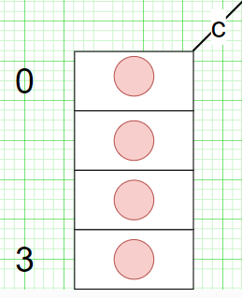
6B. DRAW A PICTURE
After the ORANGE code runs draw a picture of what RAM memory would look like?
Circle [ ] c = new Circle[4];
for(int i = 0; i< c.length; i++) {
c[i] = new Circle( );
}

Slide 16
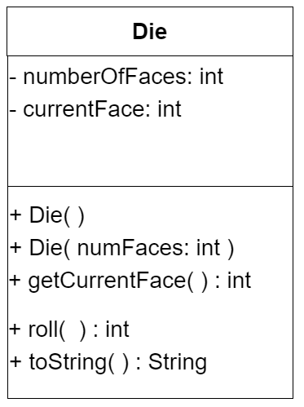
7. Array of OBJECTS
Write Java code to declare an array of 5 six-sided dice. Roll each die and output the rolls and the sum of all 5.
Sample Session

Slide 17
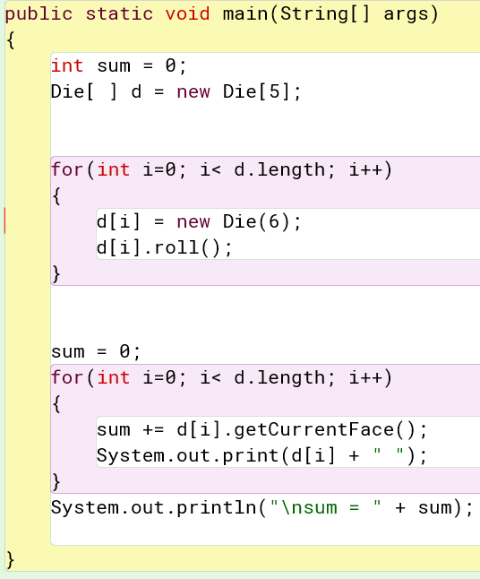
7. Array of OBJECTS
Write Java code to declare an array of 5 six-sided dice. Roll each die and output the rolls and the sum of all 5

Slide 18
8. JAVA METHODS
Suppose you have a variable named passengers which stores an array of objects of type Passenger. Write a statement which calls the getName() method for the first Passenger object in the passengers array.
Passenger
+ getName( ): String
+ setName (name: String)

Slide 19
8. JAVA METHODS
Suppose you have a variable named passengers which stores an array of objects of type Passenger. Write a statement which calls the getName() method for the first Passenger object in the passengers array.
Passenger
System.out.println(
passengers[0].getName( ) );
+ getName( ): String
+ setName (name: String)

Slide 20
9. THIS
Write a class/blueprint called, Car. The only instance variables are numDoors and make, e.g.. “a 4 door Ford”. Create three overloaded constructors as follows:
Car( )
Car( String make ) Car (String make, int numDoors)
Use the this keyword to reduce duplicate code.
Defaults: 4 doors & Ford

Slide 21
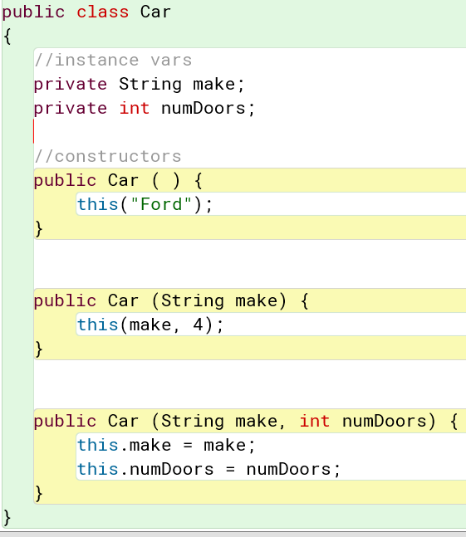
9. THIS

Slide 22
10A. ARRAYS
Write a single Java statement to declare and create an array containing the following 3 strings, “Bat”, “Bee”, “Bug”

Slide 23
10A. ARRAYS
Write a single Java statement to declare and create an array containing the following 3 strings, “Bat”, “Bee”, “Bug”
String[ ] a = { “Bat”, “Bee”, “Bug”};

Slide 24
10B. ARRAYS
Write a standard for loop to output each element in the array.

Slide 25
10B. ARRAYS
Write a standard for loop to output each element in the array.
String[ ] a = { “Bat”, “Bee”, “Bug”};
for(int i=0; i < a.length; i++)
System.out.println( a[i] );

Slide 26
10C. ARRAYS
Write an enhanced for loop to output each element in the array.

Slide 27
10C. ARRAYS
Write an enhanced for loop to output each element in the array.
String[ ] a = { “Bat”, “Bee”, “Bug”};
for( String x : a ) {
System.out.println( x );
}

Slide 28
11. ARRAY ObJECT
Assume the Die class has a constructor which specifies the number of faces a die has. Populate the array dice, with
5 six-sided dice.
dice
0
1
;
;
4

Slide 29
11. ARRAY ObJECT
Assume the Die class has a constructor which specifies the number of faces a die has. Populate the array dice, with
5 six-sided dice.
dice
Die [ ] dice = new Die [5];
0
for(int i = 0; i < dice.length; i++)
{
dice[ i ] = new Die(6);
}
1
;
;
4

Slide 30
12. ARRAYS
Assume the Circle class has a constructor which accepts the radius of the circle. Populate the array c, with 10 circles with a radius of 2.
c
0
1
;
;
9

Slide 31
12. ARRAYS
Assume the Circle class has a constructor which accepts the radius of the circle. Populate the array c, with 10 circles with a radius of 2.
c
Circle [ ] c = new Circle [10];
0
1
for(int i = 0; i < c.length; i++)
c[ i ] = new Circle(2);
;
;
9

Slide 32
13. Defaults
What is the default value for the following data types?
int ___________
double __________
String __________
boolean _________
char ____________

Slide 33
13. Defaults
What is the default value for the following data types?
int 0
double 0
String null
boolean false
char \0
All objects, which start with a capital…. default to null
The default value of a char primitive type is '\u0000'(null character) as stated in the Java Language Specification. The shortcut for 'u0000’ is '\0’, So the null can be represented either by 'u0000' or '\0'.

Slide 34
14. FOR LOOPS
Write a Java for loop which outputs the following
sequence
1 10 100 1000 10000 100000 1000000

Slide 35
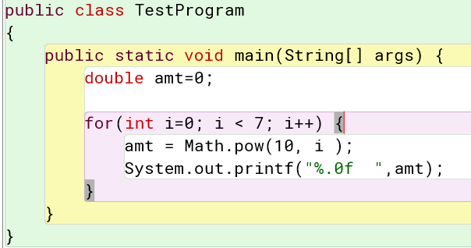
14. FOR LOOPS
Write a Java for loop which outputs the following
sequence
1 10 100 1000 10000 100000 1000000

Slide 36
15. FOR LOOPS
Write a Java for loop which outputs the following
sequence
3 6 9 12 15 18 21 24 27 30 33 36 39 42 45 48

Slide 37
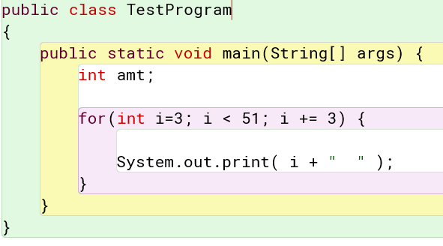
15. FOR LOOPS
Write a Java for loop which outputs the following
sequence
3 6 9 12 15 18 21 24 27 30 33 36 39 42 45 48

Slide 38
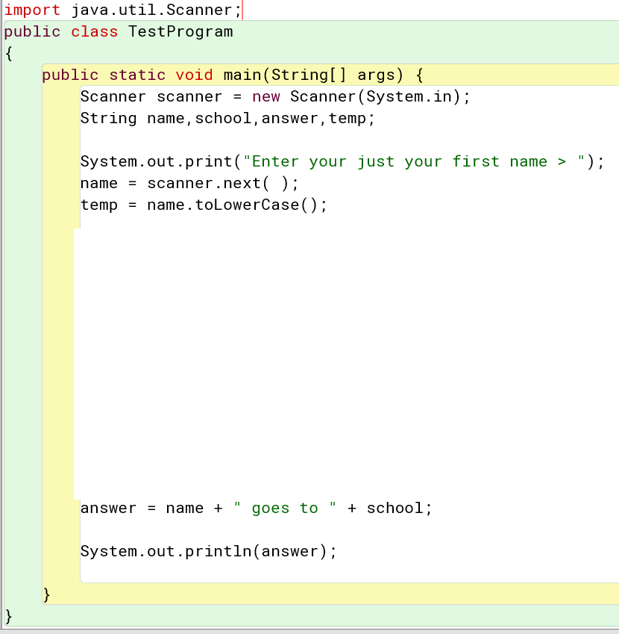
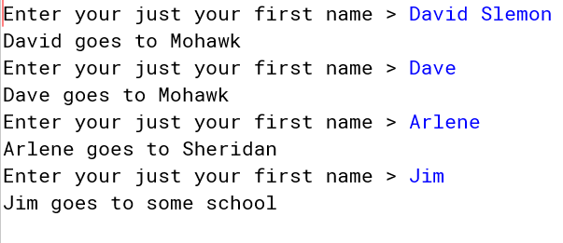
16. SWITCH
Study this program. See sample session. Add a Switch statement which correctly sets the value of “school” variable. Weird things can happen …. can you still overcome these obstacles…. a) people often add their whole name instead of just their first name to the prompt. b) some people like Dave sometimes input David. c) people sometimes use capital letters, e.g. DAVID, Dave, dave

Slide 39
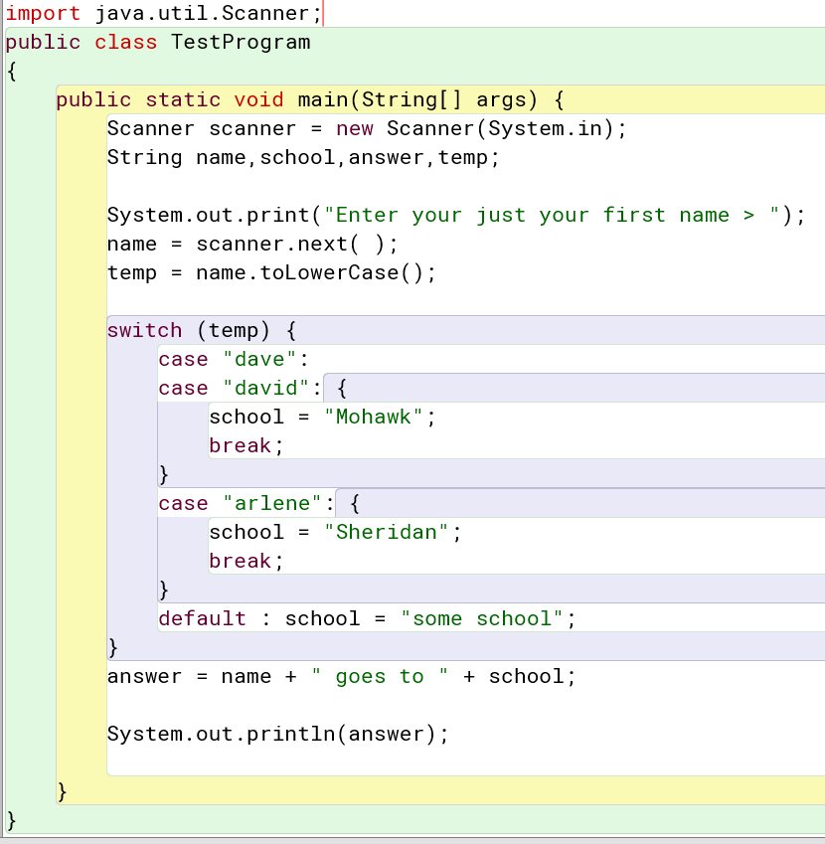
Study this program. See sample session. Add a Switch statement which correctly sets the value of “school” variable. Weird things can happen …. can you still overcome these obstacles…. a) people often add their whole name instead of just their first name to the prompt. b) some people like Dave sometimes input David. c) people sometimes use capital letters, e.g. DAVID, Dave, dave

Slide 40
17. Declare & Initialize
Just declare a variable called, pi as a double.
Initialize pi to 3.14
Change the value of pi to 3.14159

Slide 41
17. Declare & Initialize
Just declare a variable called, pi as a double.
double pi;
Initialize pi to 3.14
pi = 3.14 ;
Change the value of pi to 3.14159
pi = 3.14159 ;

Slide 42
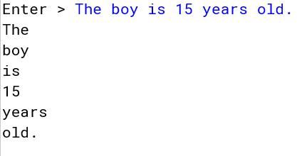
18. SCANNER
Read the following typed in line using scanner one
word at a time. Output each word separately on a line
by itself. Stop reading if you encounter the period.

Slide 43
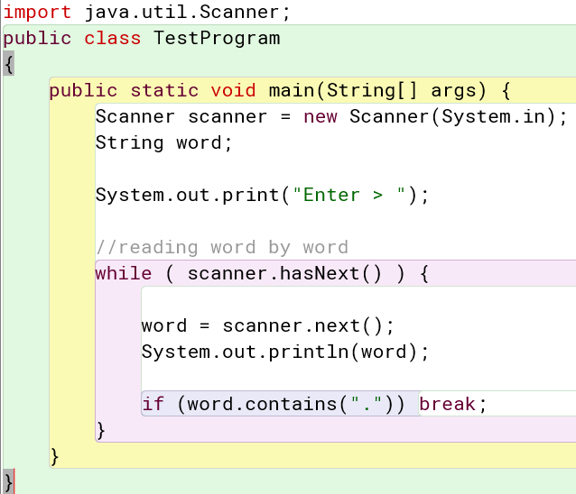
18. SCANNER
Read the following typed in line using scanner one
word at a time. Output each word separately on a line
by itself. Stop reading if you encounter the period.

Slide 44
19. Format Strings
Using printf or String.format represent as 3.1416
double pi = 3.14159;

Slide 45
19. Format Strings
Using printf or String.format represent as 3.1416
double pi = 3.14159;
System.out.printf( “%6.4f”, pi ); //displays 3.1416

