Slide 1
V107 A Review of previous days most important points.

Slide 2
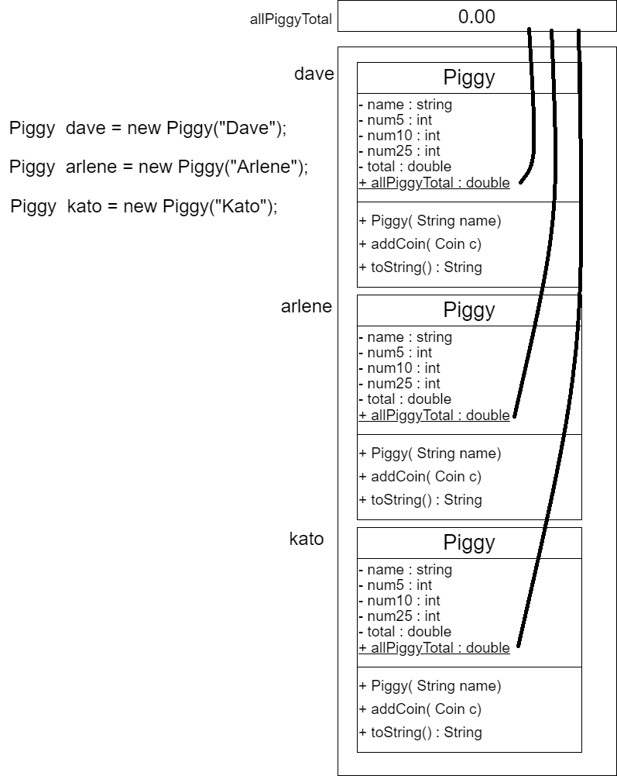
Static Class Variables
80%
allPiggyTotal is a static class variable
it’s underlined in UML diagrams
there’s just one memory location
assigned to the static variable
All instances have a reference to that
one memory variable.
allpiggyTotal is the sum of the total amount contained in all Piggy bank instances

Slide 3
Overloaded Methods
78%
Overloading is creating a method that has the same name as another method in the class (or a parent class), but with different parameters and/or return value
public double getMin( double n1, double n2 ) {
if (n1 < n2) return n1;
return n2;
}
public int getMin ( int n1, int n2 ) {
if (n1 < n2) return n1;
return n2;
}

Slide 4
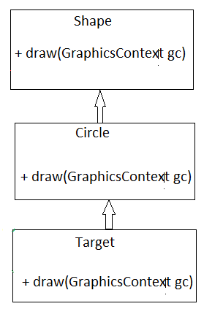
Overrided Methods
53%
Overrided methods are created when a sub (child) class that has the same name, return value, and parameters as a method in one of the super (parent) classes.
The draw method is overloaded twice in the sketch
to the right.

Slide 5
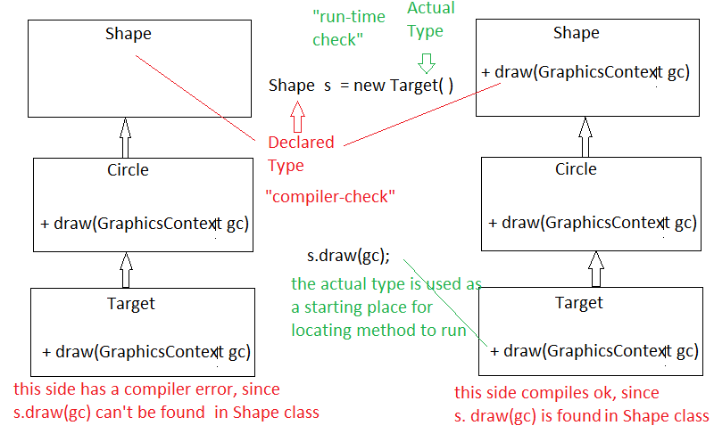
Polymorphism (tricky) The method .draw(gc) below has a declared type of Shape and an actual type of Target. The compiler checks if the declared type has a .draw(gc) method and if not generates a compiler error. The actual type, i.e. Target has a .draw(gc) method, so at run-time, this method is executed, BUT if Target didn’t have a .draw(gc) method, it would search up the inheritance tree for a .draw(gc) method.

Slide 6
67%

Slide 7
Enhanced For loop Limitations
68%
public static void main(String[] args)
{
Die [] dice = new Die [1000000];
for (Die d : dice) {
d = new Die();
}
The code above does not create Die objects in each array element because of how the enhanced for loop
works in Java.
In the enhanced for loop, the variable d is not a reference to the actual array element, but rather a
temporary variable that holds the value of each element in the array during each iteration.
Assigning a new value to d does not modify the corresponding array element.
The code is assigning a new Die object to the temporary variable d, but it does not update the array
element dice[i]. As a result, all elements of the dice array remain null.

Slide 8
To correctly initialize each array element with a Die object, you should use a regular for loop instead, like this:
public static void main(String[] args) {
Die[] dice = new Die[1000000];
for (int i = 0; i < dice.length; i++) {
dice[i] = new Die();
}
}

Slide 9
Why is Inheritance Good
Inheritance in Java provides a powerful mechanism for code reuse, flexibility, and organization, making it a fundamental concept in object-oriented programming.
Reduces duplicate code.
By extending a parent class, you inherit methods that you don’t have to re-write.
Overriding: allows you to provide specific tailored methods for a class.
Polymorphism: objects of different classes can be treated uniformly through a common interface.
Maintenance: easier to maintain the code, everything in just one spot.
Allows you to extend the functionality of existing classes by adding new features in the child classes.

Slide 10
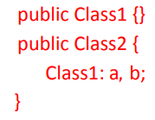
Association - refers to a “has a” relationship between 2 objects. That is, “Class2 has a Class1”
47%

Slide 11
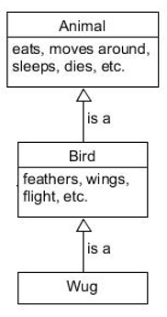
Inheritance - “is a” relation ( a class can only extend to one parent)
65%
A Wug is a Bird. A Bird is a Animal
public class Bird extends Animal {
}
public class Wug extends Bird {
}

Slide 12
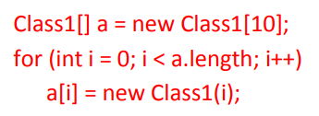
Array of Objects
67%
creates an empty array of all, null
each element becomes a Class1 inside the loop

Slide 13
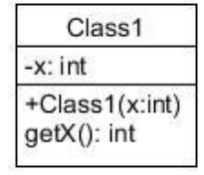
Array of Objects
called, a
System.out.println( a[2].getX() )

Slide 14
Array of Objects
Write an enhanced for loop to display all of the “x” values from each element of array, a
for ( Class1 c : a ) {
System.out.println( c.getX() );
}

Slide 15
Array of Objects
Write an standard for loop to display all of the “x” values from each element of array, a
for ( int i=0; i< a.length ; i++) {
System.out.println( a[i].getX() );
}

Slide 16
GUI Programming
66%
Suppose you have a Button called, button.
What is the trigger line in the GUI program which will
activate a handler routine to process the button’s purpose?
// 5. Add Event Handlers and do final setup quarter
button.setOnAction ( this::buttonHandler );

Slide 17
GUI Programming
44%
What is the method’s return type, name and signature if the
If the user presses the Button called, button?
button.setOnAction ( this::buttonHandler );
public void buttonHandler(ActionEvent e) {
}

Slide 18
87%

Slide 19
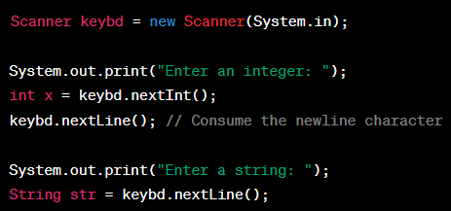
Scanner Class ( special considerations)
In this code, after entering an integer and pressing Enter,
if you try to enter a string, the nextLine() method won't
behave as expected.
It will immediately consume the newline character left
in the buffer by nextInt(), resulting in an empty string.
To address this issue, it's a common practice to
add an extra keybd.nextLine() after reading an
integer or double to consume the remaining newline
character before reading the next line.

